Slide 1
Model Evaluation
Metrics for Performance Evaluation
How to evaluate the performance of a model?
Methods for Performance Evaluation

Slide 2
Metrics for Performance Evaluation
Focus on the predictive capability of a model
Confusion Matrix
 | PREDICTED CLASS
ACTUAL CLASS |  | Class=Yes | Class=No
 | Class=Yes | a | b
 | Class=No | c | d
a: TP (true positive)
b: FN (false negative)
c: FP (false positive)
d: TN (true negative)

Slide 3
Metrics for Performance Evaluation…
 | PREDICTED CLASS
ACTUAL CLASS |  | Class=Yes | Class=No
 | Class=Yes | a (TP) | b (FN)
 | Class=No | c (FP) | d (TN)
Most widely-used metric:

Slide 4
Limitation of Accuracy
Consider a 2-class problem
Number of Class 0 examples = 9990
Number of Class 1 examples = 10
If model predicts everything to be class 0, accuracy is 9990/10000 = 99.9 %
Accuracy is misleading because model does not detect any class 1 example

Slide 5
Cost Matrix
 | PREDICTED CLASS
ACTUAL CLASS | C(i | j) | Class=Yes | Class=No
 | Class=Yes | C(Yes|Yes) | C(No|Yes)
 | Class=No | C(Yes|No) | C(No|No)
C( i | j ): Cost of misclassifying class j example as class i

Slide 6
Computing Cost of Classification
Cost Matrix | PREDICTED CLASS
ACTUAL CLASS | C(i|j) | + | -
 | + | -1 | 100
 | - | 1 | 0
Model M₁ | PREDICTED CLASS
ACTUAL CLASS |  | + | -
 | + | 150 | 40
 | - | 60 | 250
Model M₂ | PREDICTED CLASS
ACTUAL CLASS |  | + | -
 | + | 250 | 45
 | - | 5 | 200
Accuracy = 80%
Cost = 3910
Accuracy = 90%
Cost = 4255

Slide 7
Cost vs Accuracy
Count | PREDICTED CLASS
ACTUAL CLASS |  | Class=Yes | Class=No
 | Class=Yes | a | b
 | Class=No | c | d
Accuracy is proportional to cost if 1. C(Yes|No)=C(No|Yes) = q 2. C(Yes|Yes)=C(No|No) = p
N = a + b + c + d
Accuracy = (a + d)/N
Cost = p (a + d) + q (b + c)
= p (a + d) + q (N – a – d)
= q N – (q – p)(a + d)
= N [q – (q-p) × Accuracy]
Cost | PREDICTED CLASS
ACTUAL CLASS |  | Class=Yes | Class=No
 | Class=Yes | p | q
 | Class=No | q | p

Slide 8
Measures for Imbalanced Classes

Slide 9
Methods for Performance Evaluation
How to obtain a reliable estimate of performance?
Performance of a model may depend on other factors besides the learning algorithm:
Class distribution
Cost of misclassification
Size of training and test sets

Slide 10
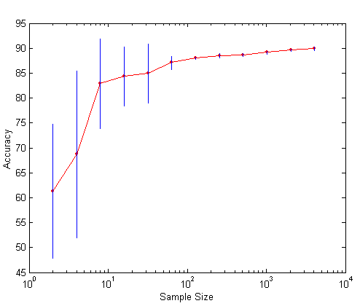
Learning Curve
Learning curve shows how accuracy changes with varying sample size
Requires a sampling schedule for creating learning curve:
Arithmetic sampling (Langley, et al)
Geometric sampling (Provost et al)
Effect of small sample size:
Bias in the estimate
Variance of estimate

Slide 11
Methods of Estimation
Holdout
Reserve 2/3 for training and 1/3 for testing
Random subsampling
Repeated holdout
Cross validation
Partition data into k disjoint subsets
k-fold: train on k-1 partitions, test on the remaining one
Leave-one-out: k=n
Stratified sampling
oversampling vs undersampling
Bootstrap
Sampling with replacement

Slide 12
ROC (Receiver Operating Characteristic)
Developed in 1950s for signal detection theory to analyze noisy signals
Characterize the trade-off between positive hits and false alarms
ROC curve plots TP (on the y-axis) against FP (on the x-axis)
Performance of each classifier represented as a point on the ROC curve
changing the threshold of algorithm, sample distribution or cost matrix changes the location of the point

Slide 13
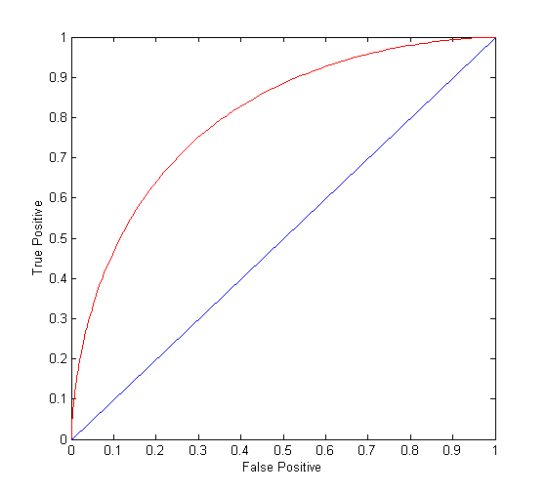
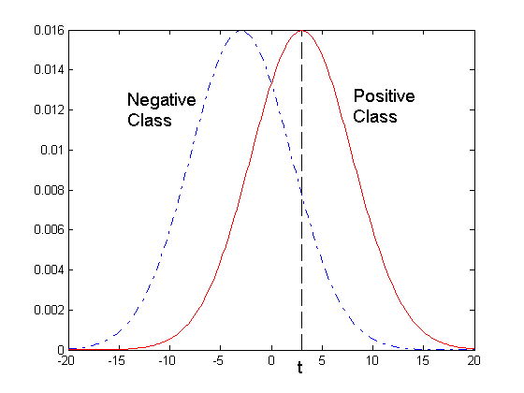
ROC Curve
1-dimensional data set containing 2 classes (positive and negative)
any points located at x > t is classified as positive
At threshold t:
TP=0.5, FN=0.5, FP=0.12, TN=0.88

Slide 14
ROC Curve
(TP,FP):
(0,0): declare everything to be negative class
(1,1): declare everything to be positive class
(1,0): ideal
Diagonal line:
Random guessing
Below diagonal line:
prediction is opposite of the true class

Slide 15
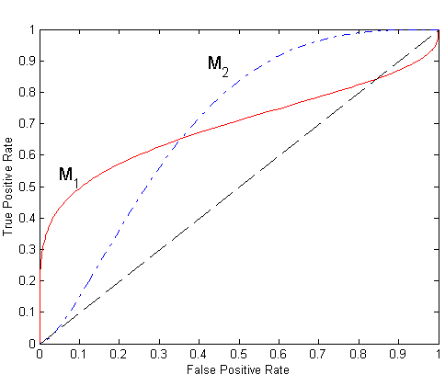
Using ROC for Model Comparison
No model consistently outperform the other
M₁ is better for small FPR
M₂ is better for large FPR
Area Under the ROC curve
Ideal:
Area = 1
Random guess:
Area = 0.5

Slide 16
How to Construct an ROC curve
Instance | P(+|A) | True Class
1 | 0.95 | +
2 | 0.93 | +
3 | 0.87 | -
4 | 0.85 | -
5 | 0.85 | -
6 | 0.85 | +
7 | 0.76 | -
8 | 0.53 | +
9 | 0.43 | -
10 | 0.25 | +
Use classifier that produces posterior probability for each test instance P(+|A)
Sort the instances according to P(+|A) in decreasing order
Apply threshold at each unique value of P(+|A)
Count the number of TP, FP, TN, FN at each threshold
TP rate, TPR = TP/(TP+FN)
FP rate, FPR = FP/(FP + TN)

Slide 17
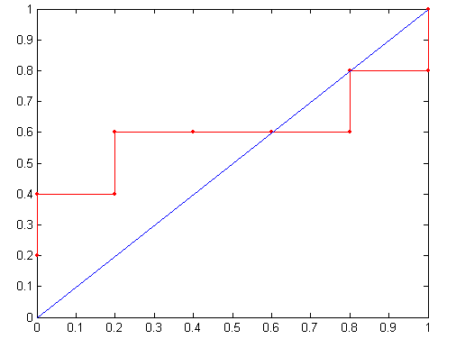
How to construct an ROC curve
ROC Curve:
Threshold >=

Slide 18
Test of Significance
Given two models:
Model M1: accuracy = 85%, tested on 30 instances
Model M2: accuracy = 75%, tested on 5000 instances
Can we say M1 is better than M2?
How much confidence can we place on accuracy of M1 and M2?
Can the difference in performance measure be explained as a result of random fluctuations in the test set?

Slide 19
Confidence Interval for Accuracy
Prediction can be regarded as a Bernoulli trial
A Bernoulli trial has 2 possible outcomes
Possible outcomes for prediction: correct or wrong
Collection of Bernoulli trials has a Binomial distribution:
x ∼ Bin(N, p) x: number of correct predictions
e.g: Toss a fair coin N=50 times, how many heads would turn up? Expected number of heads = N×p = 50 × 0.5 = 25
Given x (# of correct predictions) or equivalently, acc=x/N, and N (# of test instances), Can we predict p (true accuracy of model)?

Slide 20
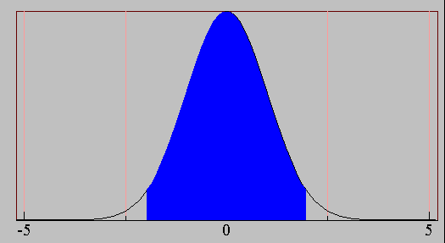
Confidence Interval for Accuracy
Area = 1 - α
For large test sets (N > 30),
acc has a normal distribution with mean p and variance p(1-p)/N
Confidence Interval for p:
Z_{α/2}
Z_{1- α /2}

Slide 21
Confidence Interval for Accuracy
Consider a model that produces an accuracy of 80% when evaluated on 100 test instances:
N=100, acc = 0.8
Let 1-α = 0.95 (95% confidence)
From probability table, Z_{α/2}=1.96
1-α | Z
0.99 | 2.58
0.98 | 2.33
0.95 | 1.96
0.90 | 1.65
N | 50 | 100 | 500 | 1000 | 5000
p(lower) | 0.670 | 0.711 | 0.763 | 0.774 | 0.789
p(upper) | 0.888 | 0.866 | 0.833 | 0.824 | 0.811

Slide 22
Comparing Performance of Two Models
Given two models, say M1 and M2, which is better?
M1 is tested on D1 (size=n1), found error rate = e₁
M2 is tested on D2 (size=n2), found error rate = e₂
Assume D1 and D2 are independent
If n1 and n2 are sufficiently large, then
Approximate:

Slide 23
Comparing Performance of Two Models
To test if performance difference is statistically significant: d = e1 – e2
d ~ N(d_{t},σ_{t}) where d_{t} is the true difference
Since D1 and D2 are independent, their variance adds up:
At (1-α) confidence level,

Slide 24
An Illustrative Example
Given: M1: n1 = 30, e1 = 0.15 M2: n2 = 5000, e2 = 0.25
d = |e2 – e1| = 0.1 (2-sided test)
At 95% confidence level, Z_{α/2}=1.96 => Interval contains 0 => difference may not be statistically significant

Slide 25
Comparing Performance of Two Algorithms
Each learning algorithm may produce k models:
L1 may produce M11 , M12, …, M1k
L2 may produce M21 , M22, …, M2k
If models are generated on the same test sets D1,D2, …, Dk (e.g., via cross-validation)
For each set: compute d_{j} = e_{1j} – e_{2j}
d_{j} has mean d_{t} and variance σ_{t}
Estimate:

Slide 26
Thank You!
In our next segment: Hyperparameter Optimization

Slide 27
Hyperparameter optimization
Dr. Sugata Ghosal
sugata.ghosal@pilani.bits-pilani.ac.in

Slide 28
Hyperparameters
Machine Learning systems use many parameters internally
Gradient Descent
e.g., Learning rate, how long to run
Mini-batch
Batch size
Regularization constant
Many Others
will be discussed in upcoming sessions

Slide 29
From Theory
Theoretical analysis of some class of problems gives us a recipe for assigning hyperparameters
Also gives guarantees that the algorithm will converge with some optimal rate
This is usually enough to get an asymptotically optimal rate
Certainly in the worst case

Slide 30
Hyperparameter Optimization
Also called metaparameter optimization
Also called tuning
How to find best values of hyperparameters?

Slide 31
Tuning By Hand
Just fiddle with the parameters until you get the results you want
Probably the most common type of hyperparameter optimization
Upsides: the results are generally pretty good…
Downsides: lots of effort, and no theoretical guarantees

Slide 32
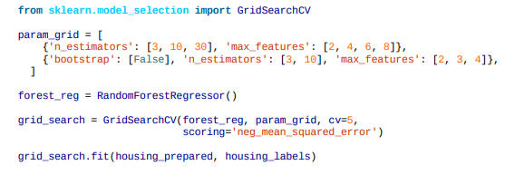
Grid Search
Define some grid of parameters you want to try
Try all the parameter values in the grid
By running the whole system for each setting of parameters
Then choose the setting with the best result
Essentially a brute force method

Slide 33
Downsides of Grid Search
As the number of parameters increases, the cost of grid search increases exponentially!
Need some way to choose the grid properly
Something this can be as hard as the original hyperparameter optimization
Can’t take advantage of any insight you have about the system!

Slide 34
Making Grid Search Fast
Early stopping to the rescue
Can run all the grid points for one epoch, then discard the half that performed worse, then run for another epoch, discard half, and continue.
Can take advantage of parallelism
Run all the different parameter settings independently on different servers in a cluster.
An embarrassingly parallel task.
Downside: doesn’t reduce the energy cost.

Slide 35
One Variant: Random Search
This is just grid search, but with randomly chosen points instead of points on a grid.
RandomSearchCV
This solves the curse of dimensionality
Don’t need to increase the number of grid points exponentially as the number of dimensions increases.
Problem: with random search, not necessarily going to get anywhere near the optimal parameters in a finite sample.

Slide 36
One Variant: Best Ball
Works with epochs.
At each epoch, do a small grid search around the current hyperparameter settings
Then evaluate the objective and choose the “best ball”
The choice of parameters that gave the best objective for that epoch
And repeat until a solution of desired quality is achieved.

Slide 37
An Alternative: Bayesian Optimization
Statistical approach for minimizing noisy black-box functions.
Idea: learn a statistical model of the function from hyperparameter values to the loss function
Then choose parameters to minimize the loss
Main benefit: choose the hyperparameters to test not at random, but in a way that gives the most information about the model
This lets it learn faster than grid search

Slide 38
Effect of Bayesian Optimization
Downside: it’s a pretty heavyweight method
The updates are not as simple-to-implement as grid search
Upside: empirically it has been demonstrated to get better results in fewer experiments
Compared with grid search and random search
Pretty widely used method
Lots of research opportunities here.

Slide 39
A related method: Derivative Free Optimization
Derivative-free optimization
Also called zeroth-order optimization
These methods optimize a function using only evaluations, no derivatives
Ideal for use with metaparameter optimization
Also ideal for reinforcement learning

Slide 40
The opposite of DFO: Gradient-based Optimization
These strategies say: “I’m doing SGD to learn, I may as well use it to optimize my hyperparameters.”
When we can efficiently differentiate with respect to the hyperparameters, this strategy actually works pretty well.
But generally, we can’t do it.

Slide 41
Methods that Look at the Data
Many methods look at curvature/variance info to decide how to set hyperparameters, and update their settings throughout the algorithm
Example: ADAGRAD
Example: Adam
Which you will be reading in a few weeks.

Slide 42
How to evaluate the hyperparameters?
Unlike the model parameters, we’re not given a loss function
Can’t we just use the training loss?
Not always: we don’t want to overfit the hyperparameters
Especially not when they are things that affect the model

Slide 43
Cross-Validation
Partition part of the available data to create an validation dataset that we don’t use for training.
Then use that set to evaluate the hyperparameters.
Typically, multiple rounds of cross-validation are performed using different partitions
Can get a very good sense of how good the hyperparameters are
But at a significant computational cost!

Slide 44
Thank You!
In our next segment: Machine Learning Pipeline

Slide 45
Machine Learning Pipeline
Dr. Sugata Ghosal
sugata.ghosal@pilani.bits-pilani.ac.in

Slide 46
In This Segment
What is MLOps
DevOps vs MLOps
Level 0 MLOps
Continuous Training
Level 1 MLOps
Continuous Integration, Delivery
Frameworks

Slide 47
What is MLOps?
Apply DevOps principles to ML systems
An engineering culture and practice that aims at unifying ML system development (Dev) and ML system operation (Ops).
Automation and monitoring at all steps of ML system construction, including integration, testing, releasing, deployment and infrastructure management.
Data scientists can implement and train an ML model with predictive performance on an offline validation (holdout) dataset, given relevant training data for their use case.
However, the real challenge is building an integrated ML system and to continuously operate it in production.

Slide 48
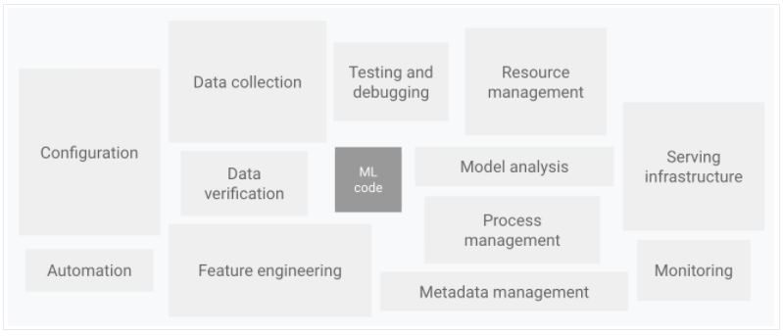
Ecosystem of ML System Components
A small fraction of a real-world ML system is composed of the ML code

Slide 49
DevOps Vs. MLOps
DevOps for developing and operating large-scale software systems provides benefits such as
shortening the development cycles
increasing deployment velocity, and
dependable releases.
Two key concepts
Continuous Integration (CI)
Continuous Delivery (CD)
An ML system is a software system, so similar practices apply to reliably build and operate at scale.
However, ML systems differ from other software systems
Team skills: focus on exploratory data analysis, model development, and experimentation.
Development: ML is experimental in nature.
The challenge is tracking what worked and what did not, maintaining reproducibility, and maximizing code reusability.
Testing: Additional testing needed for data validation, trained model quality evaluation, and model validation.

Slide 50
DevOps Vs. MLOps
Deployment: a multi-step pipeline to automatically retrain and deploy model.
adds complexity
Automation needed before deployment by data scientists to train and validate new models.
Production: ML models can have reduced performance due to constantly evolving data profiles.
Need to track summary statistics of data and
monitor the online performance of model to send notifications or roll back for suboptimal values
ML and other software systems are similar in CI of source control, unit / integration testing, and CD of the software module / package.
However, in ML,
CI is also about testing and validating data, data schemas, and models.
CD is a system (an ML training pipeline) that automatically deploys another service (model prediction service).
Continuous training (CT) is a new property, unique to ML systems, that is concerned with automatically retraining the model in production and serving the models.

Slide 51
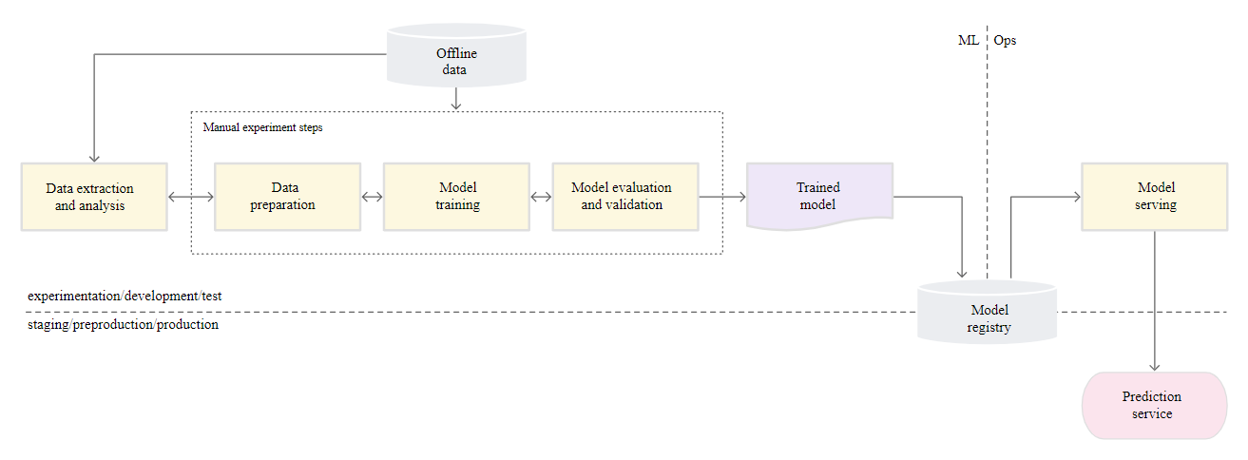
Manual ML Steps
Manual, script-driven, and interactive process.
Disconnection between ML and operations, possibly leading to training-serving skew
Infrequent release iterations. No CI, CD, active performance monitoring
Deploy trained Model as a prediction service
Deployment process is concerned only with deploying the trained model as a prediction service, e.g., a microservice with a REST API

Slide 52
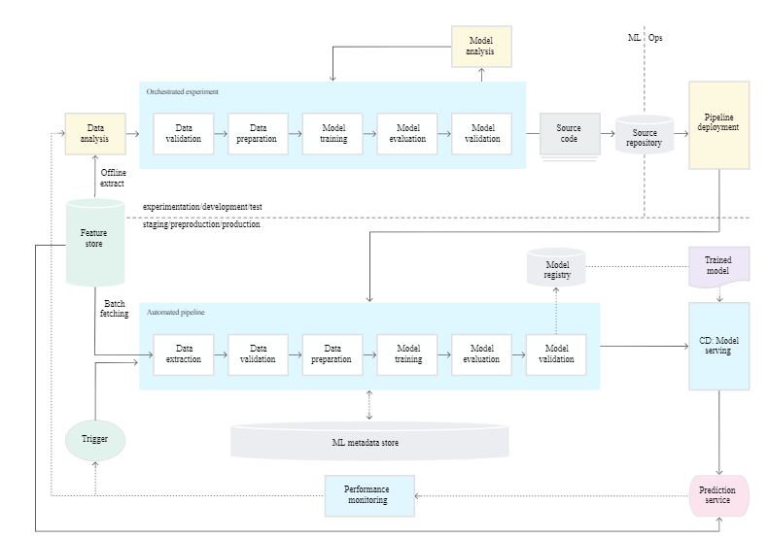
MLOps Level 1
Perform continuous training (CT) by automating the ML pipeline
Achieves continuous delivery of model prediction service.
Automated data and model validation steps to the pipeline
Needs pipeline triggers and metadata management.

Slide 53
Data and Model Validation
Data validation: Required prior to model training to decide whether to retrain the model or stop the execution of the pipeline based on following
Data values skews: significant changes in the statistical properties of data, triggering retraining
Data schema skews: downstream pipeline steps, including data processing and model training, receives data that doesn't comply with the expected schema.
stop the pipeline to release a fix or an update to the pipeline to handle these changes in the schema.
Schema skews include receiving unexpected features or with unexpected values, not receiving all the expected features
Model validation: Required after retraining the model with the new data. Evaluate and validate the model before promoting to production. This offline model validation step consists of
Producing evaluation metric using the trained model on test data to assess the model quality.
Comparing the evaluation metrics of production model, baseline model, or other business-requirement models.
Ensuring the consistency of model performance on various data segments
Test model for deployment, including infrastructure compatibility and API consistency
Undergo online model validation—in a canary deployment or an A/B testing setup

Slide 54
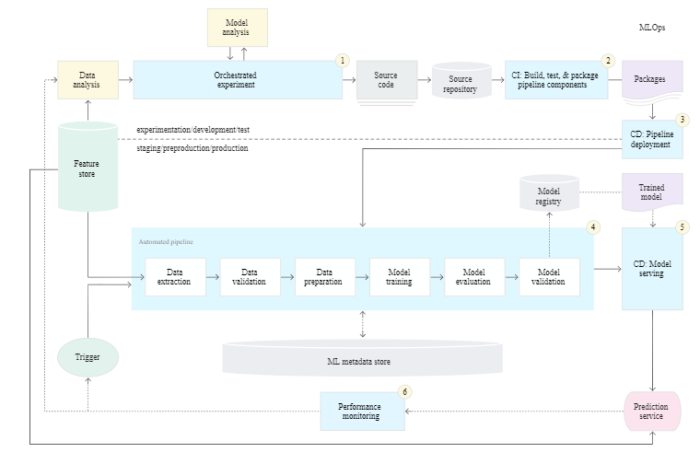
Level 2: CI/CD and automated pipeline automation
Notes:
Enables rapid and reliable update of the pipelines in production.
Enables rapid exploration of new ideas around feature engineering, model architecture, and hyperparameters.
They can implement these ideas and automatically build, test, and deploy the new pipeline components to the target environment.

Slide 55
Stages of CI/CD Automation Pipeline
Development and experimentation: iteratively try new ML algorithms and modeling. The output is the source code of the ML pipeline steps that are then pushed to a source repository.
Pipeline continuous integration: build source code and run various tests. The outputs of this stage are pipeline components (packages, executables, and artifacts).
Pipeline continuous delivery: deploy artifacts produced by the CI stage to the target environment.
Automated training: automatically executed in production based on a schedule or trigger. The output is a trained model pushed to the model registry.
Model continuous delivery: serve the trained model as a prediction service for the predictions.
Monitoring: collect statistics on the model performance based on live data. The output is a trigger to execute the pipeline or to execute a new experiment cycle.

Slide 56
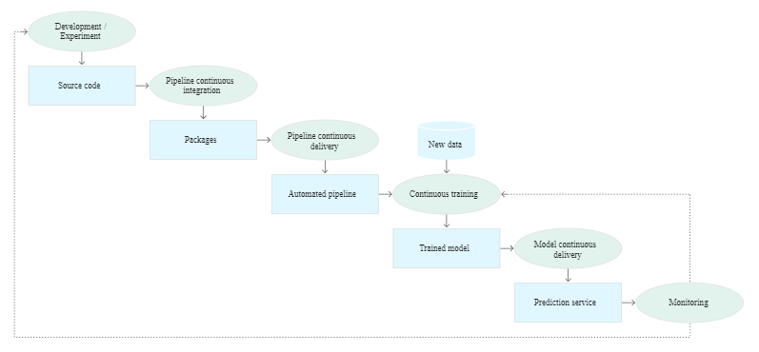
Stages of the CI/CD automated ML pipeline

Slide 57
Continuous Integration
Pipeline and its components are built, tested, and packaged when
new code is committed or
pushed to the source code repository.
Besides building packages, container images, and executables, CI process can include
Unit testing feature engineering logic.
Unit testing the different methods implemented in your model.
For example, you have a function that accepts a categorical data column and you encode the function as a one-hot feature.
Testing for training convergence
Testing for NaN values due to dividing by zero or manipulating small or large values.
Testing that each component in the pipeline produces the expected artifacts.
Testing integration between pipeline components.

Slide 58
Continuous Delivery
Continuously delivers new pipeline implementations to the target environment
prediction services of the newly trained model.
For rapid and reliable continuous delivery of pipelines and models, consider
Verifying the compatibility of the model with the target infrastructure
e.g., required packages are installed in the serving environment
Availability of memory, compute, and accelerator resources.
Testing the prediction service by calling the service API for the updated model
Testing prediction service performance, such as throughput, latency.
Validating the data either for retraining or batch prediction.
Verifying that models meet the predictive performance targets prior to deployment.
Automated deployment to a test environment, triggered by new code to the development branch.
Semi-automated deployment to a pre-production environment, triggered by code merging
Manual deployment to a production from pre-production.

Slide 59
Frameworks
Cloud Vendors are providing MLOps framework
https://cloud.google.com/solutions/machine-learning/mlops-continuous-delivery-and-automation-pipelines-in-machine-learning
Kubeflow and Cloud Build
Amazon AWS MLOps
Microsoft Azure MLOps

Slide 60
Thank You!
In our next segment: Linear Regression

Slide 61
Linear Regression Introduction
Dr. Sugata Ghosal
CSIS Off-Campus Faculty
BITS Pilani

Slide 62
Session Content
What is Linear regression
Approaches to linear regression
Least Squares Based Solution
Direct Solution

Slide 63
Regression
Wish to learn a function f :: X → Y , where predicted output Y is real, given the n training instances {<x¹,y¹>…<x^{n},y^{n}>}.
Examples include
predict weight from gender, height, age, …
Predict house price from locality, area, income, …
predict Google stock price today from Google, Yahoo, MSFT prices yesterday
predict each pixel intensity in robot’s current camera image, from previous image and previous action

Slide 64
Two Approaches
Least squares function fitting given {<x¹,y¹>…<x^{n} , y^{n}>}
Statistical (Bayesian) Approach
Choose some parameterized form for P(Y|X; θ)
θ is the vector of regression parameters
Derive regression parameters as Maximum Conditional Likelihood Estimate (MCLE) for θ

Slide 65
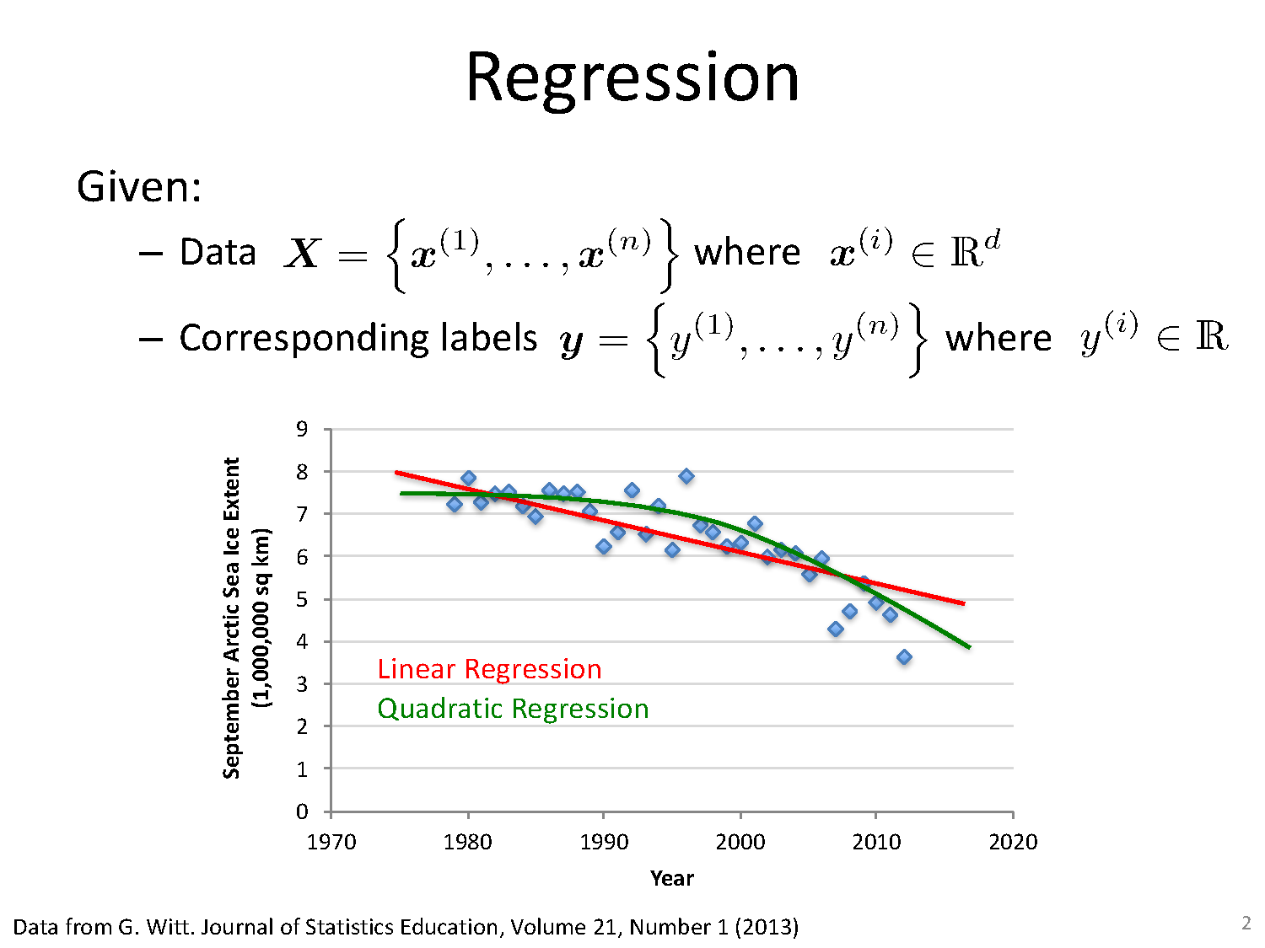
Least Squares Approach

Slide 66
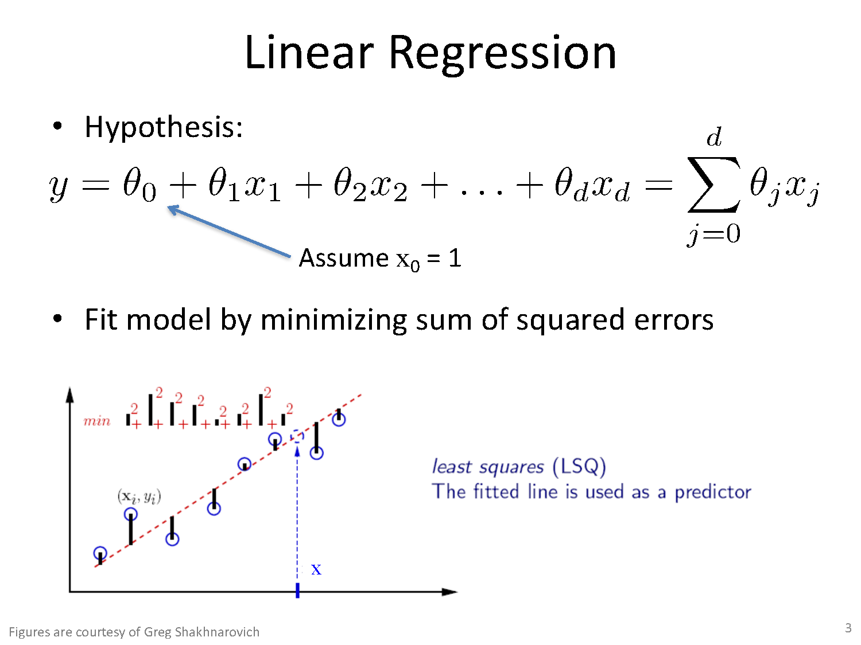
Linear Regression

Slide 67
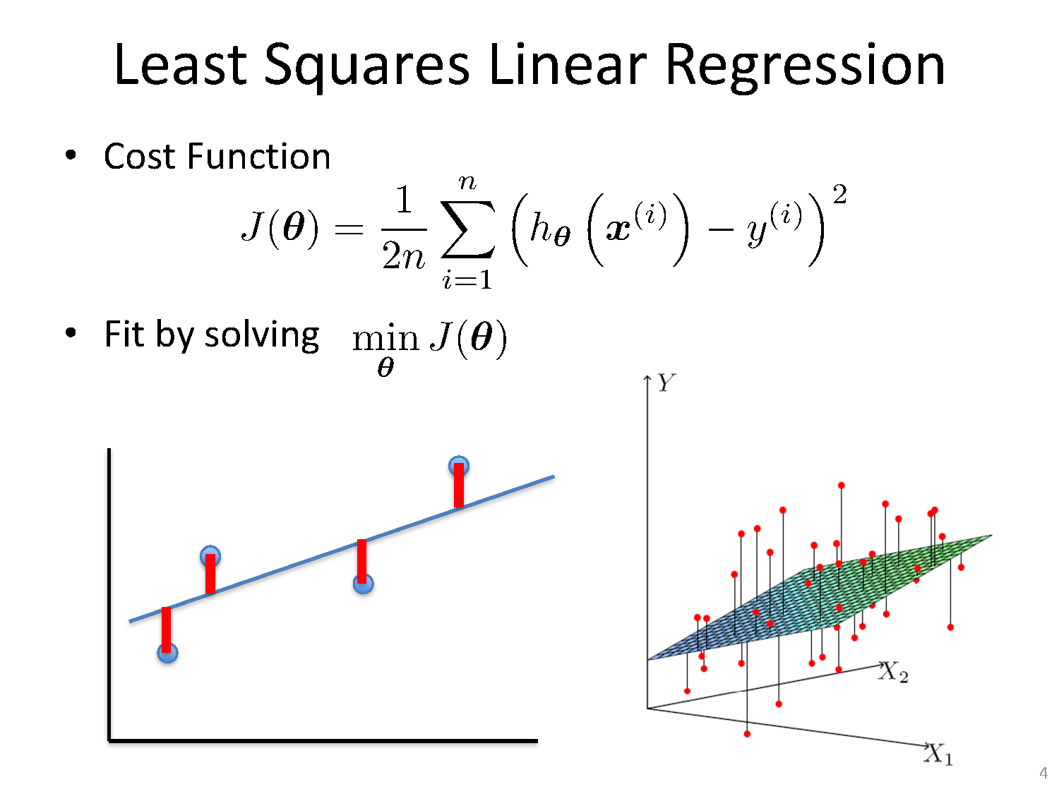
Least Squares Linear Regression

Slide 68
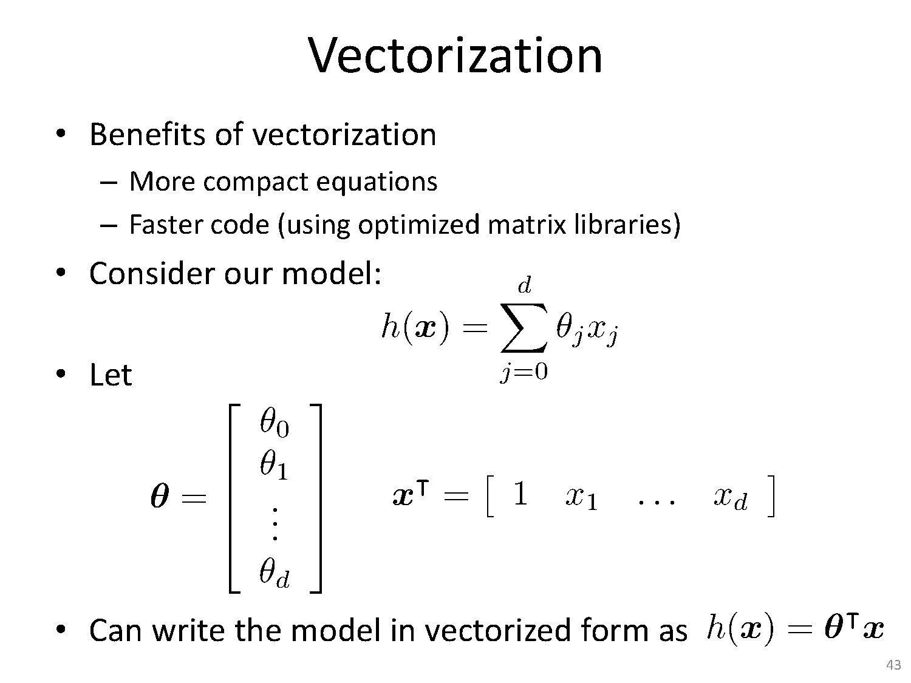
Least Squares Based Solution

Slide 69
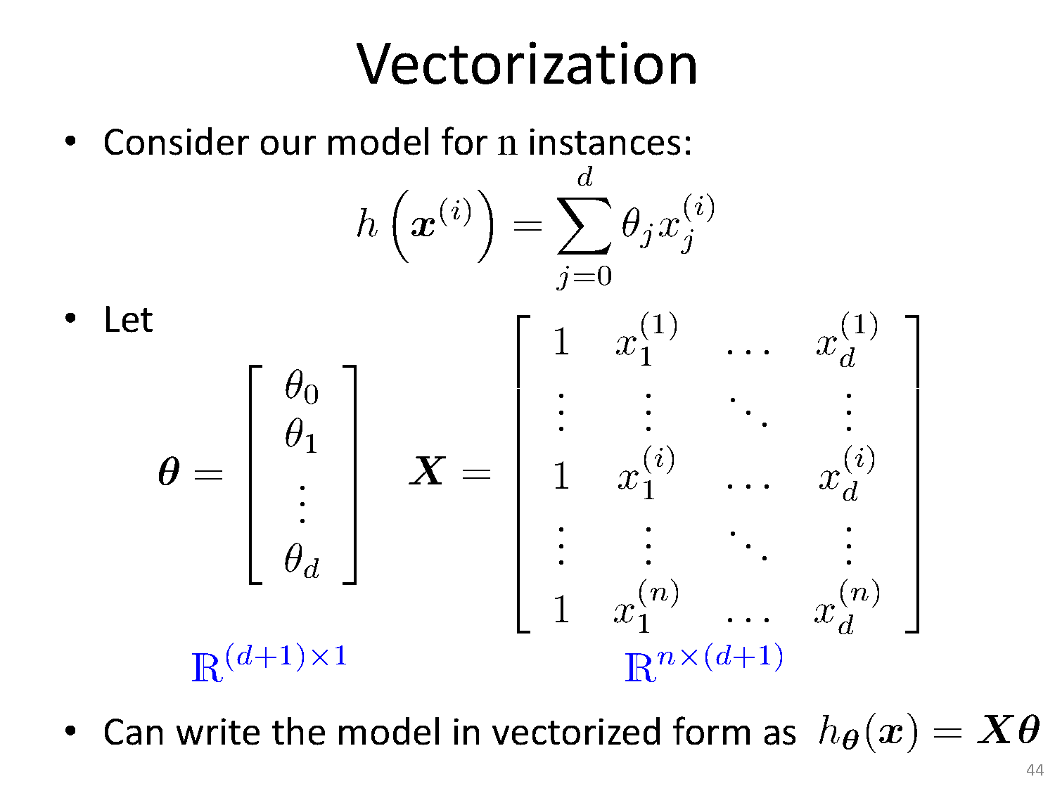
Least Squares Based Solution

Slide 70
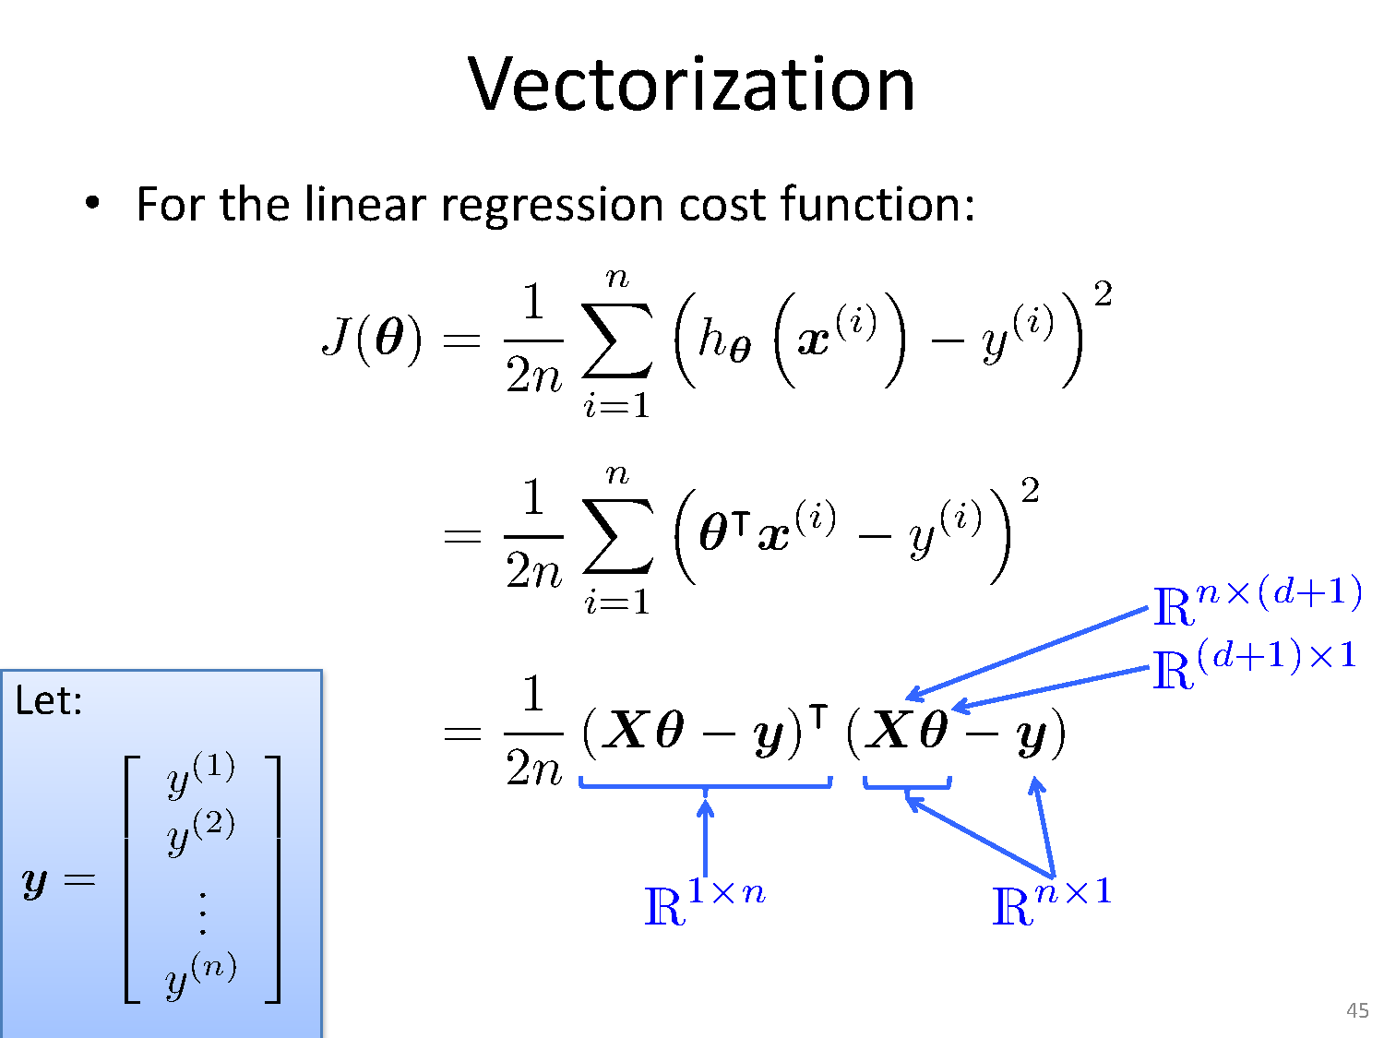
Least Squares Based Solution

Slide 71
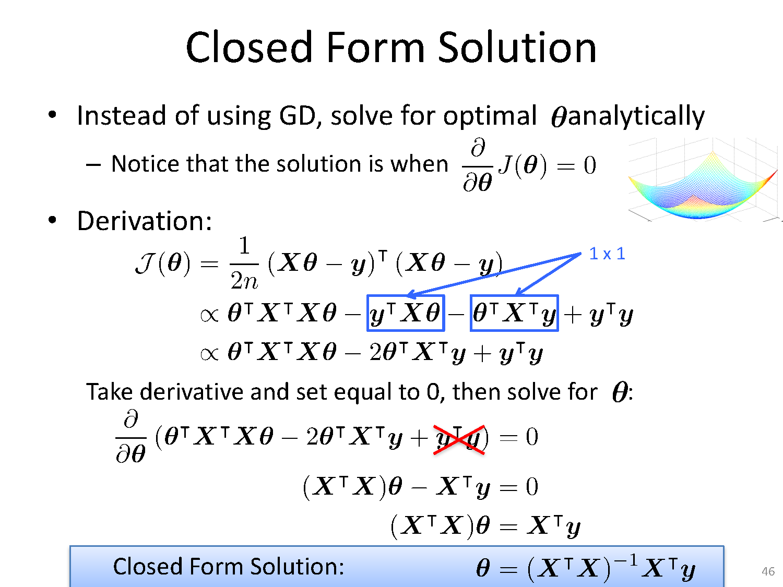
Least Squares Based Solution
Solve for optimal θ analytically

Slide 72
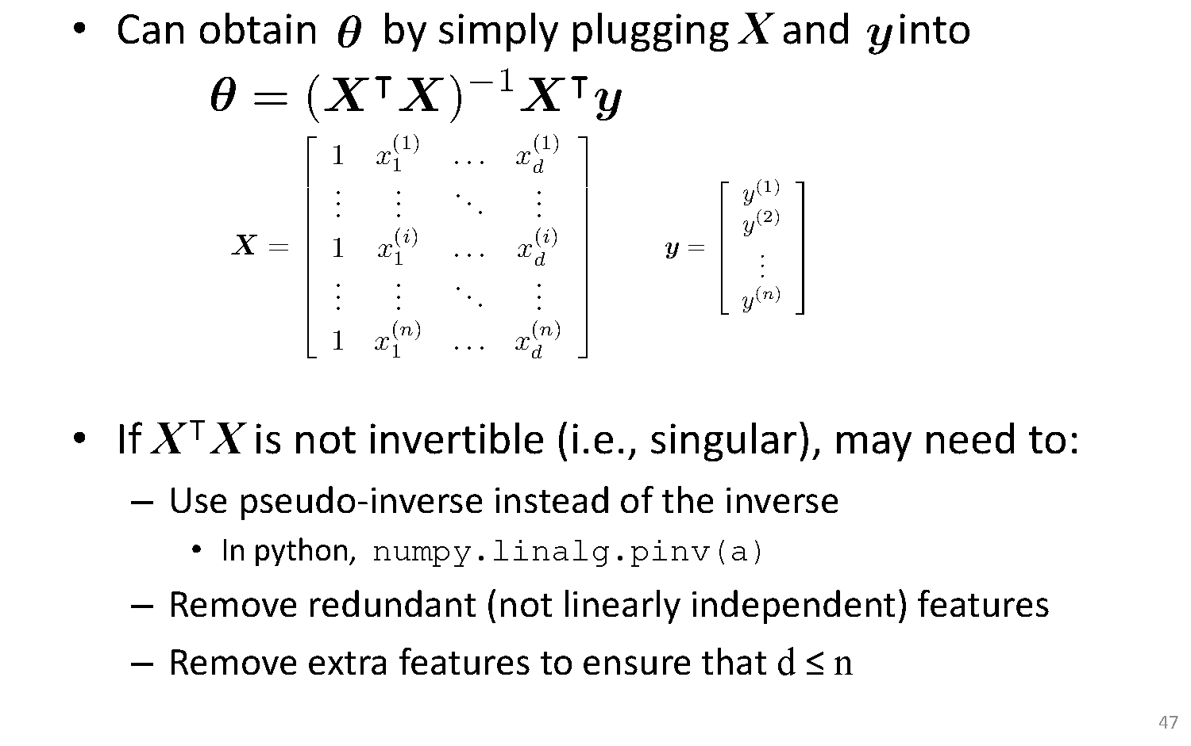
Least Squares Based Solution

Slide 73
Thank You!
In our next session: Gradient Descent

Slide 74
Linear Regression Gradient Descent
Dr. Sugata Ghosal
CSIS Off-Campus Faculty
BITS Pilani

Slide 75
Session Content
Intuition Behind Regression Cost Function
Gradient Descent Based Solution
Types of Gradient Descent
Batch
Stochastic
Minibatch

Slide 76
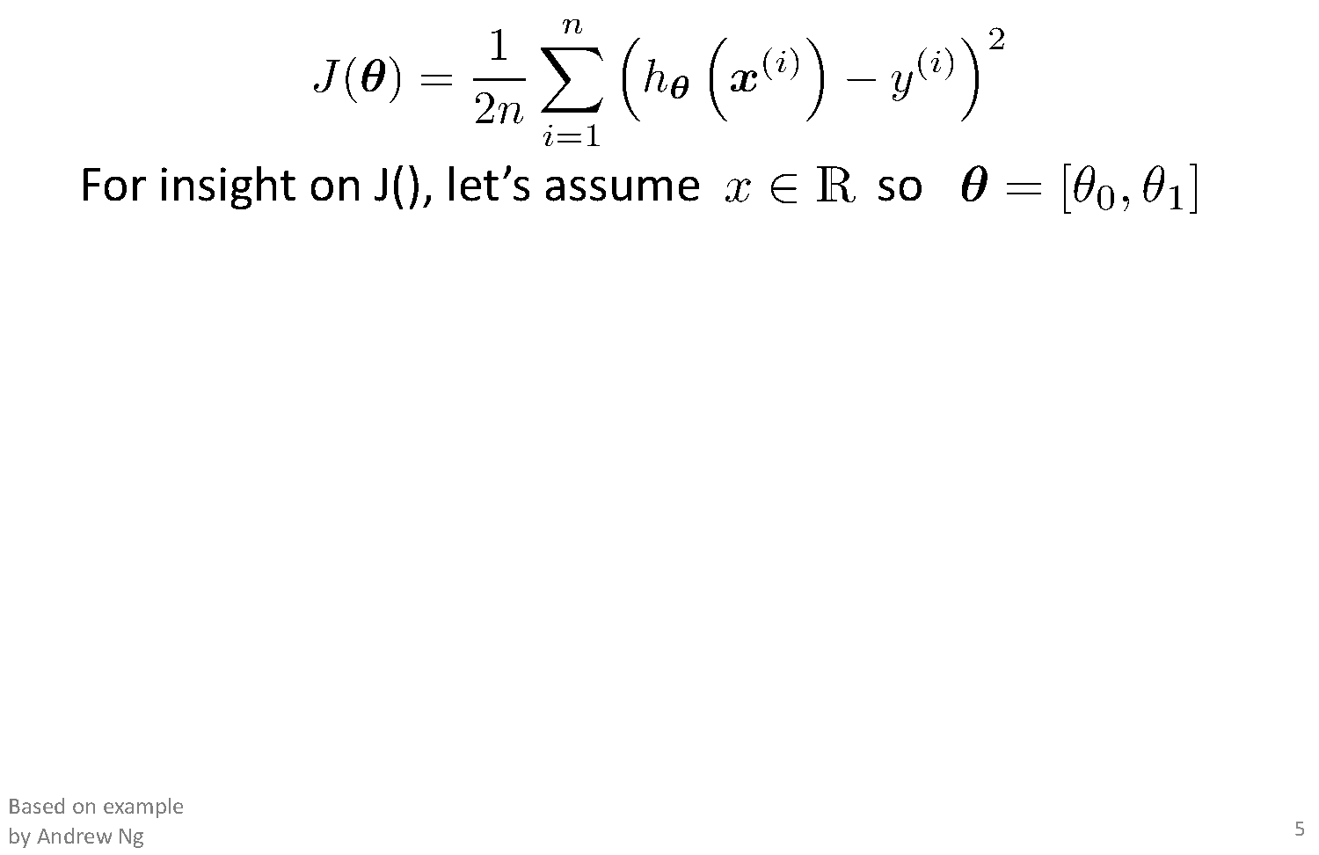
Intuition Behind Cost Function

Slide 77
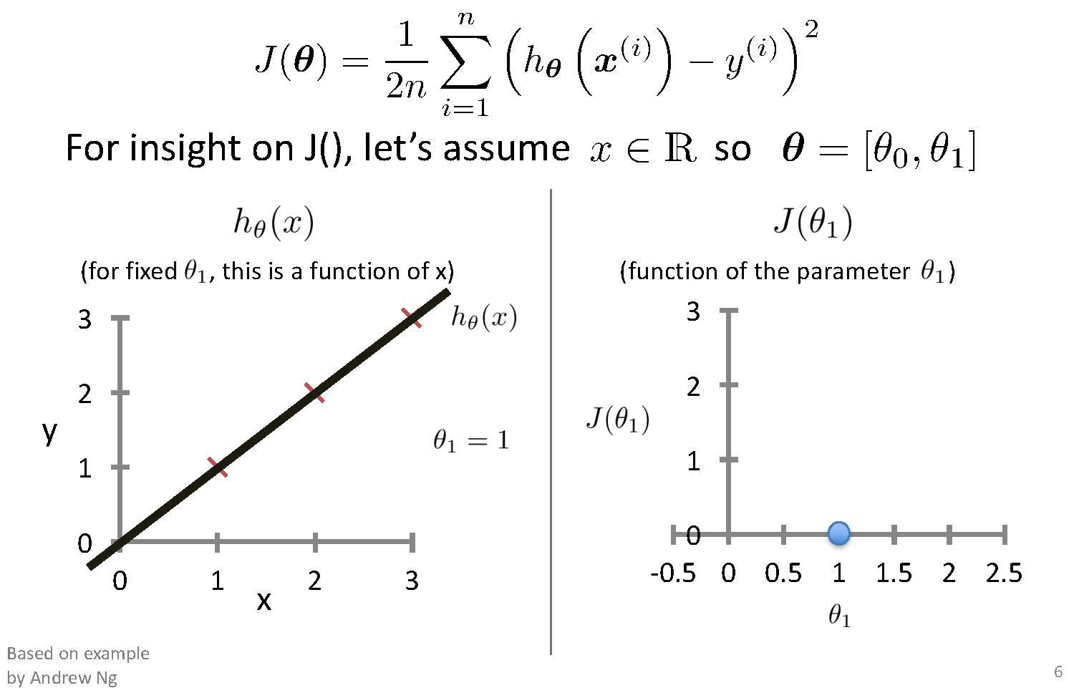
Intuition Behind Cost Function
Ɵ₀ =0

Slide 78
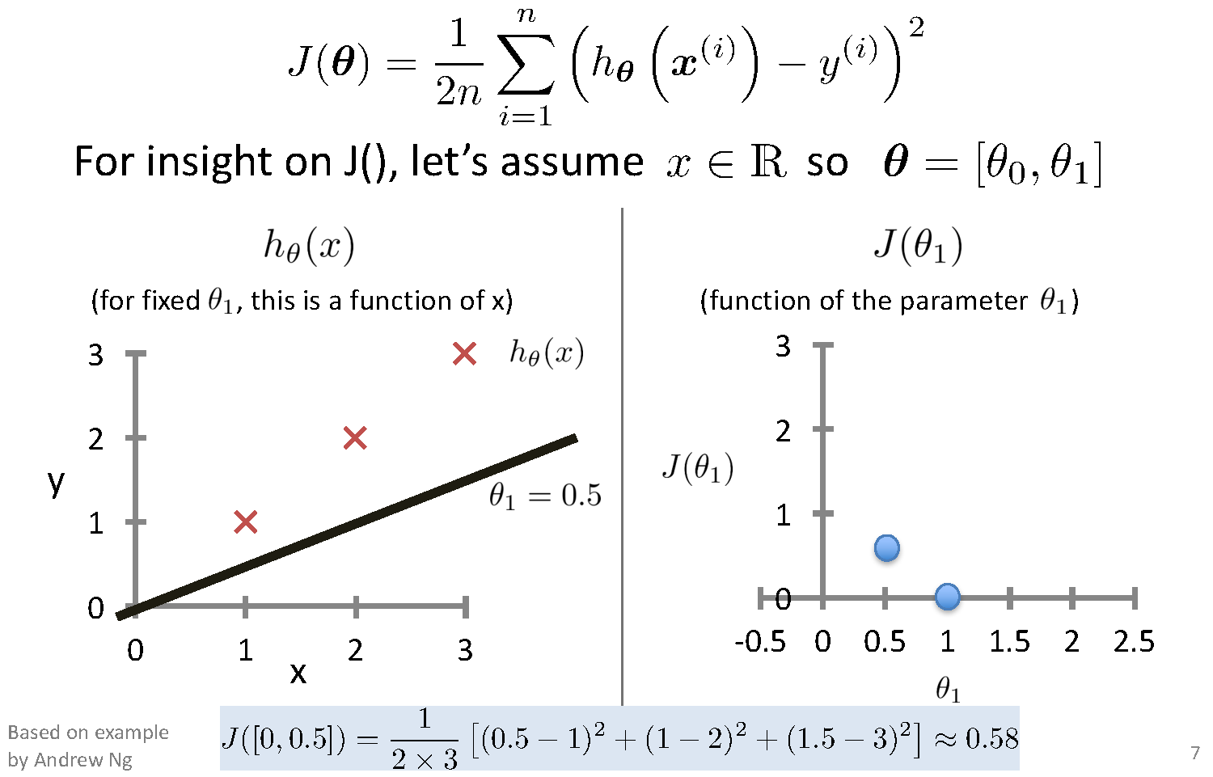
Intuition Behind Cost Function
Ɵ₀ =0

Slide 79
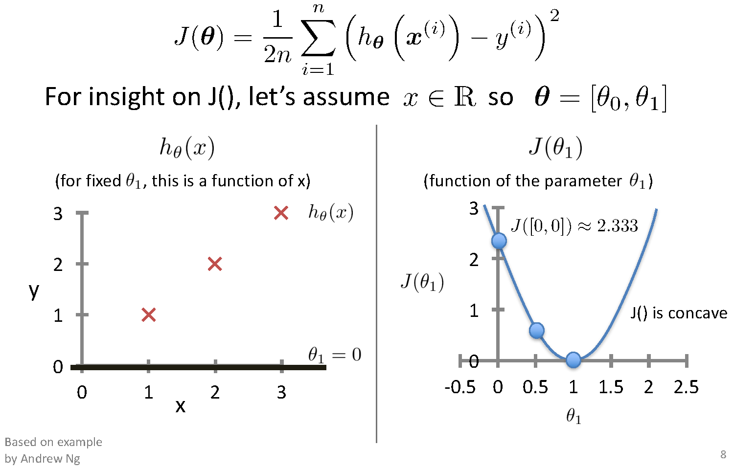
Intuition Behind Cost Function

Slide 80
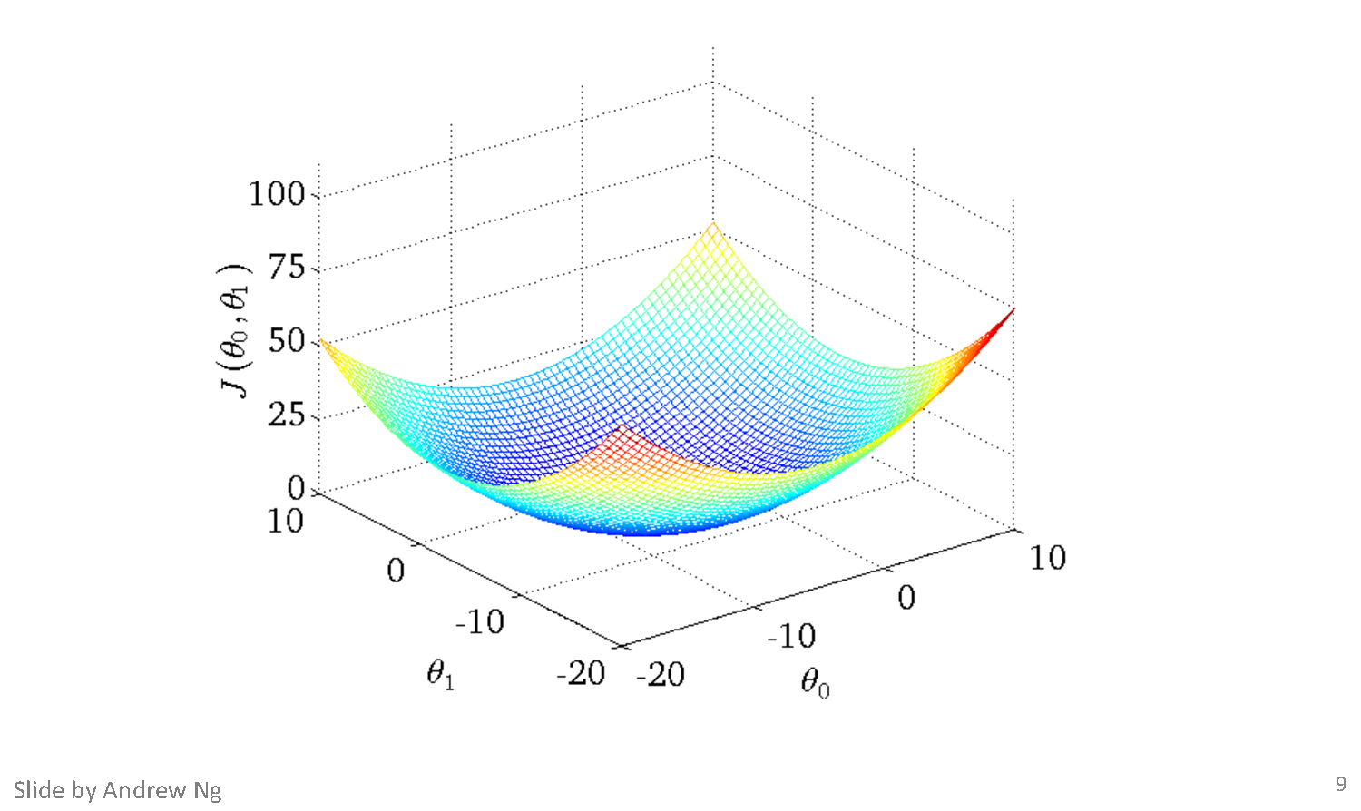
Intuition Behind Cost Function

Slide 81
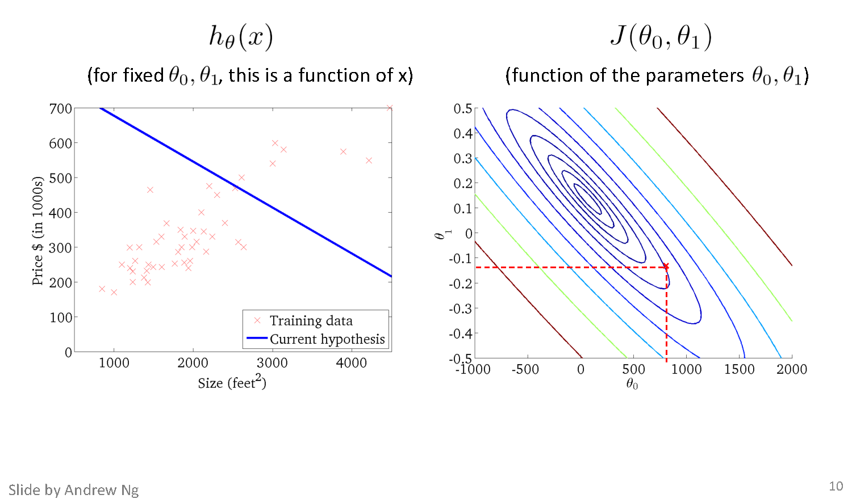
Intuition Behind Cost Function
(900,-0.1)
h(x)=900-0.1x

Slide 82
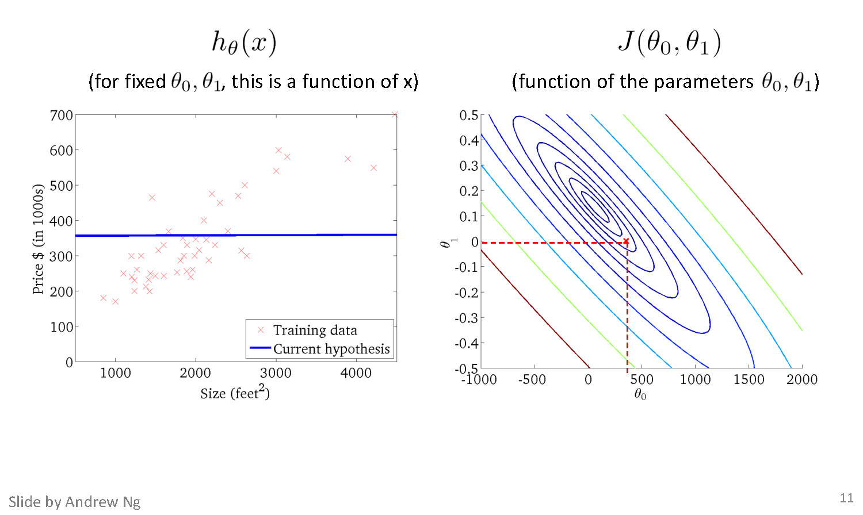
Intuition Behind Cost Function

Slide 83
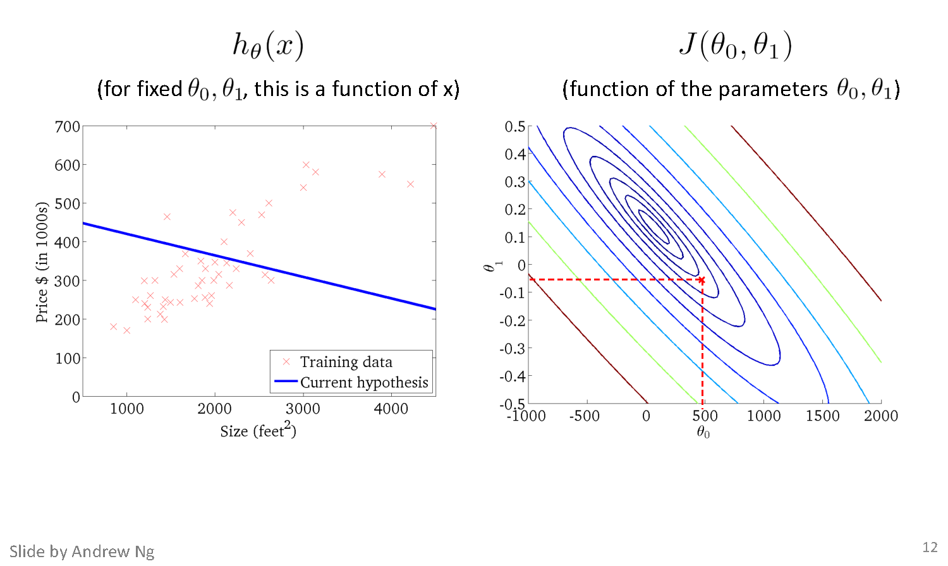
Intuition Behind Cost Function

Slide 84
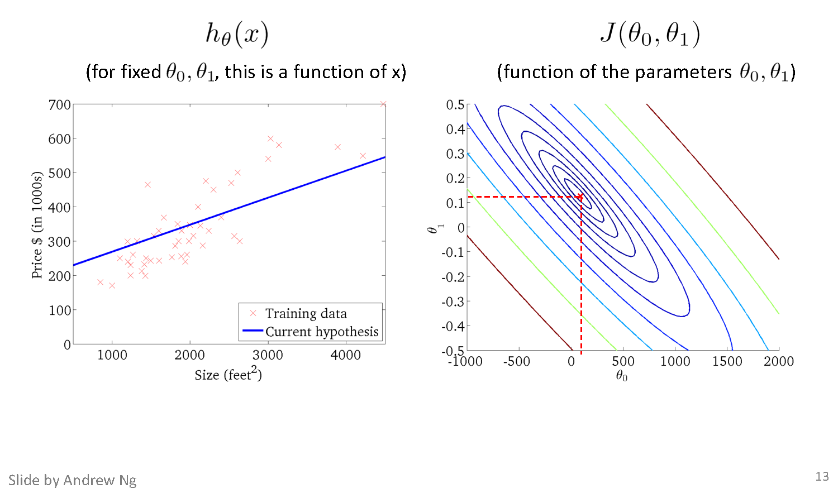
Intuition Behind Cost Function

Slide 85
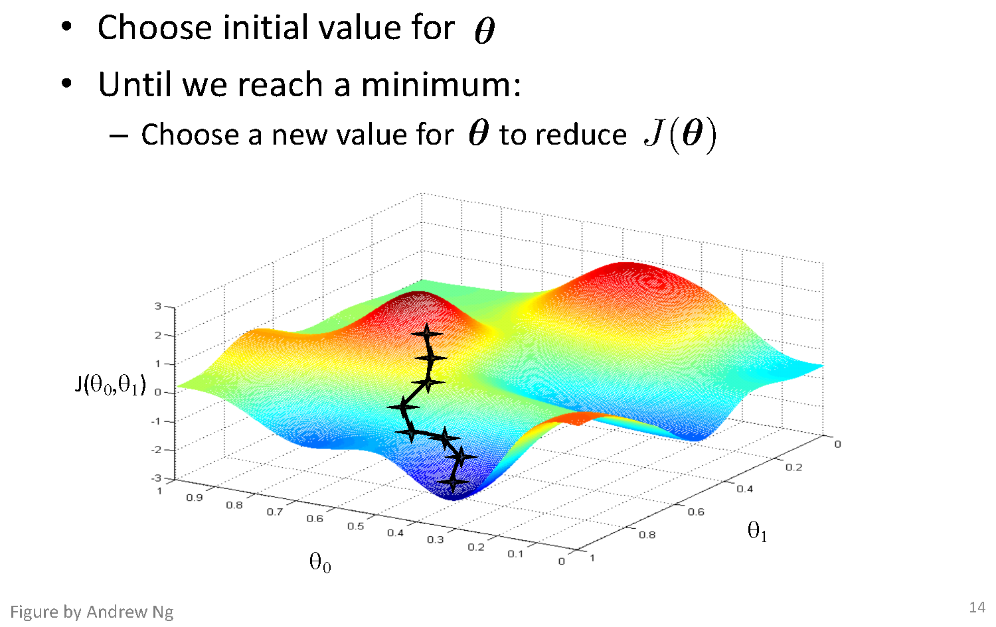
Basic Search Procedure

Slide 86
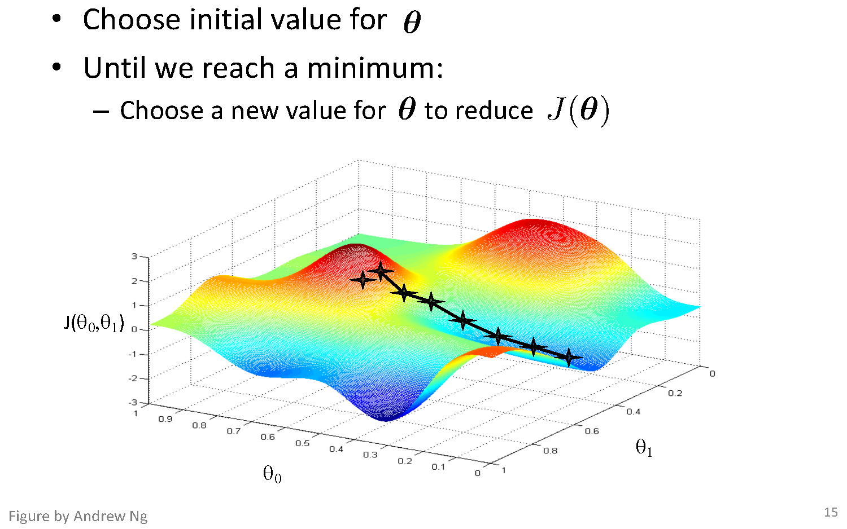
Basic Search Procedure

Slide 87
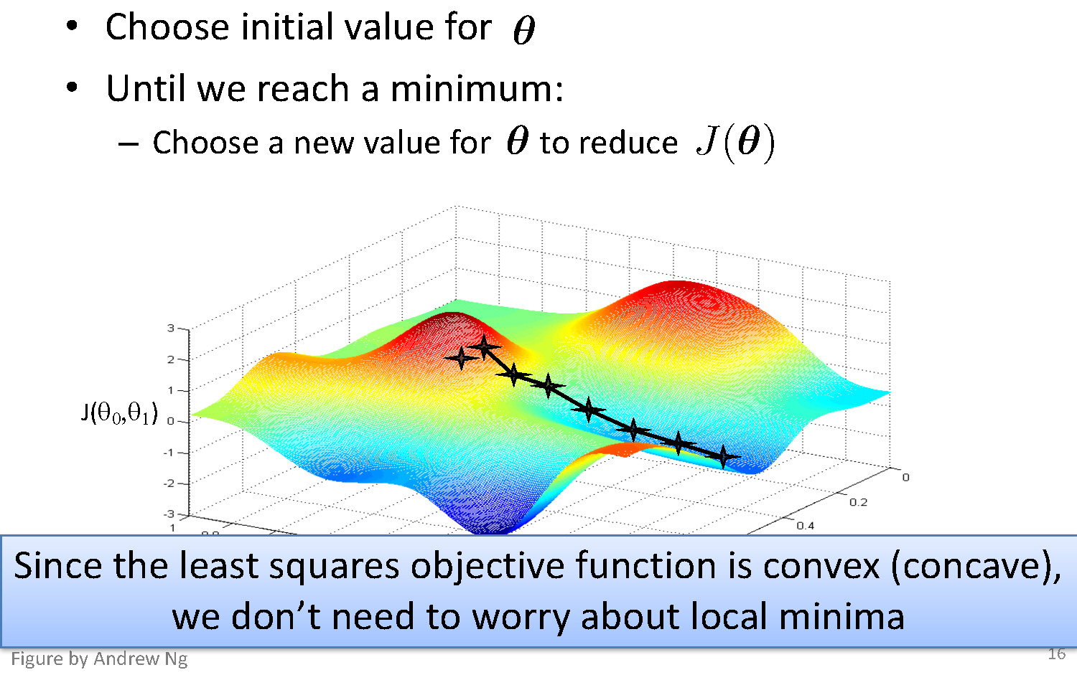
Basic Search Procedure

Slide 88
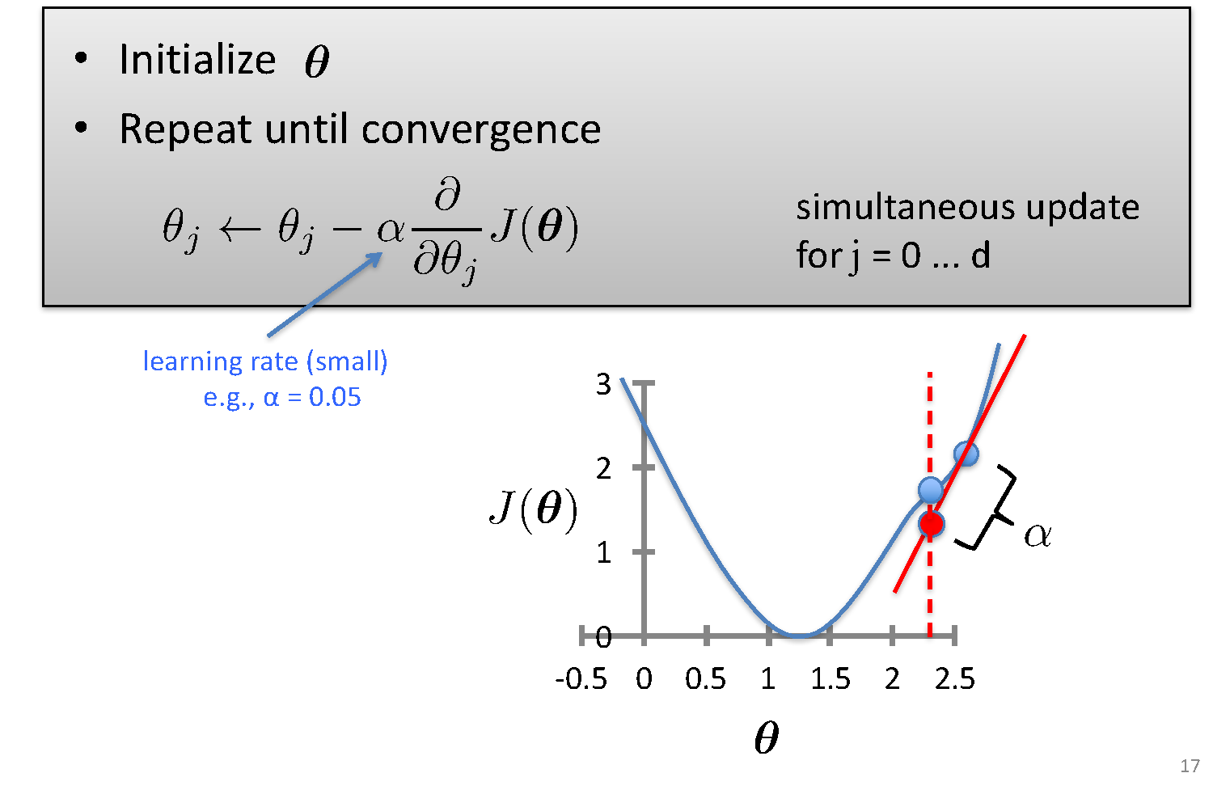
Gradient Descent

Slide 89
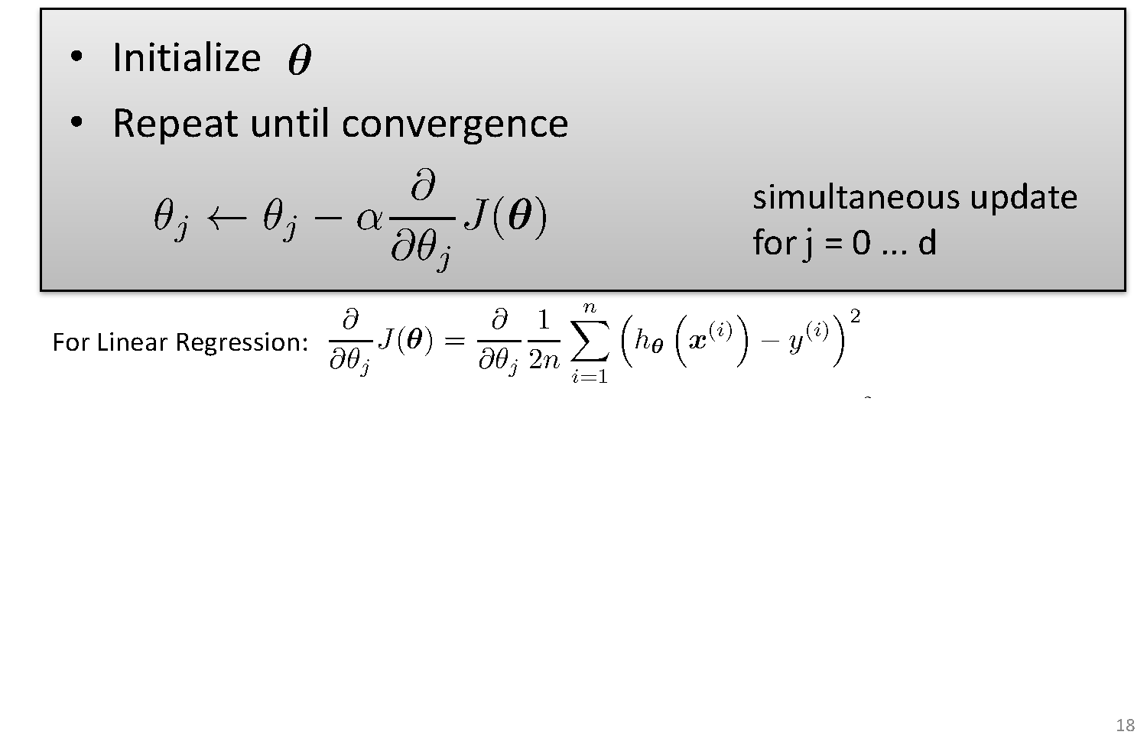
Gradient Descent

Slide 90
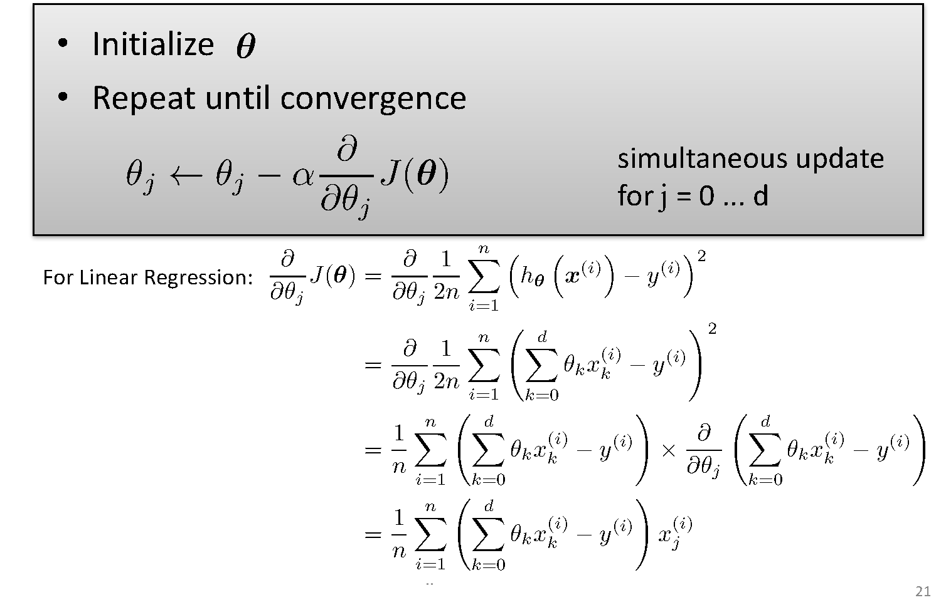
Gradient Descent

Slide 91
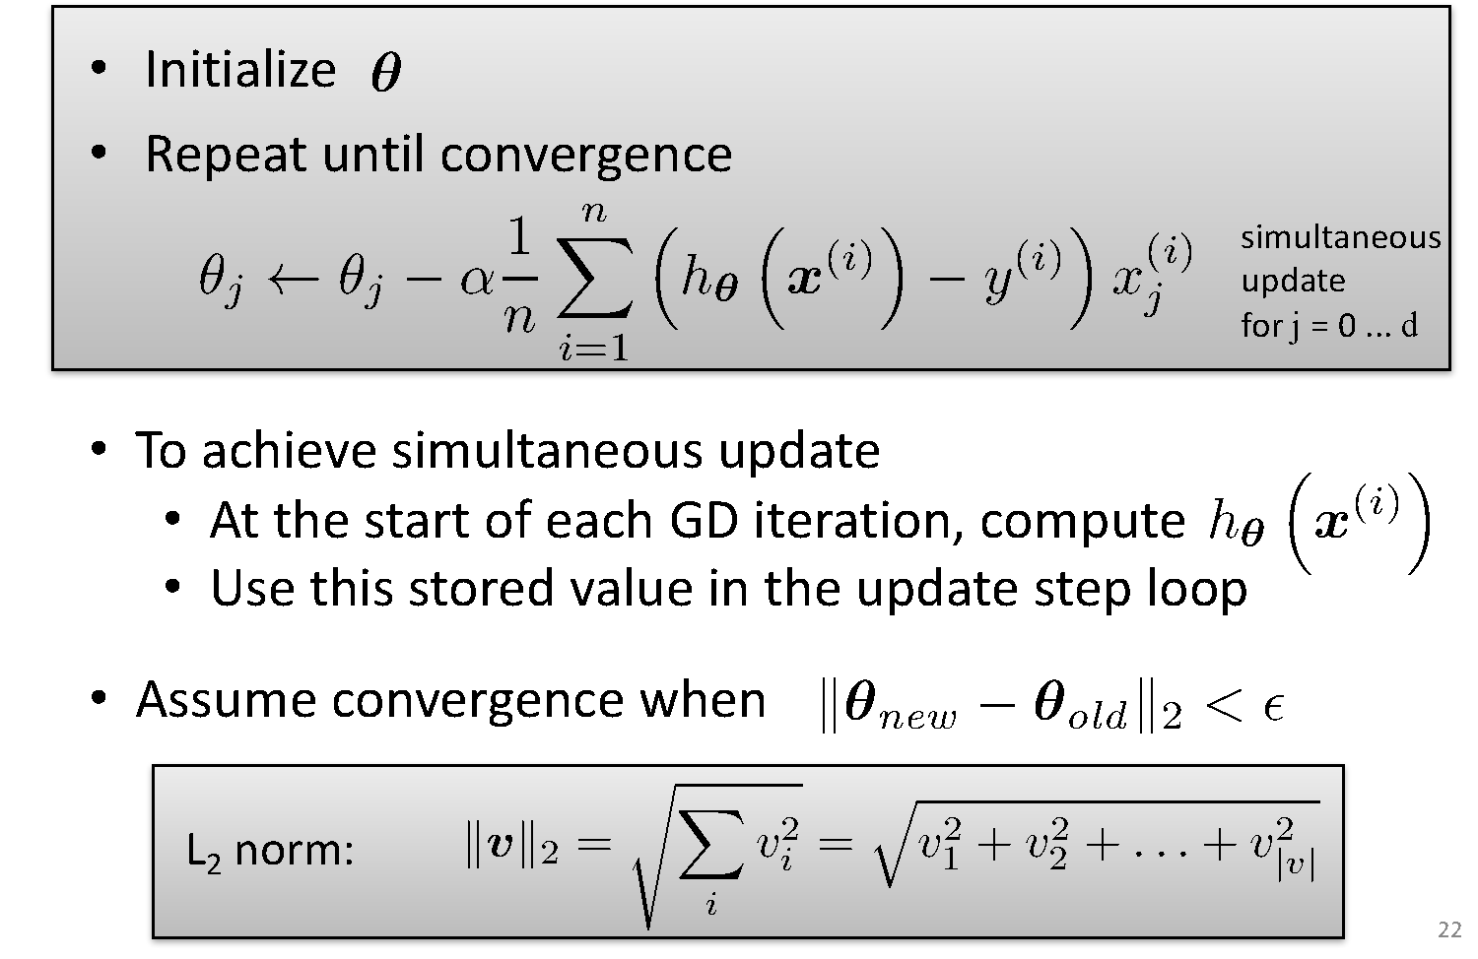
Gradient Descent for Linear Regression

Slide 92
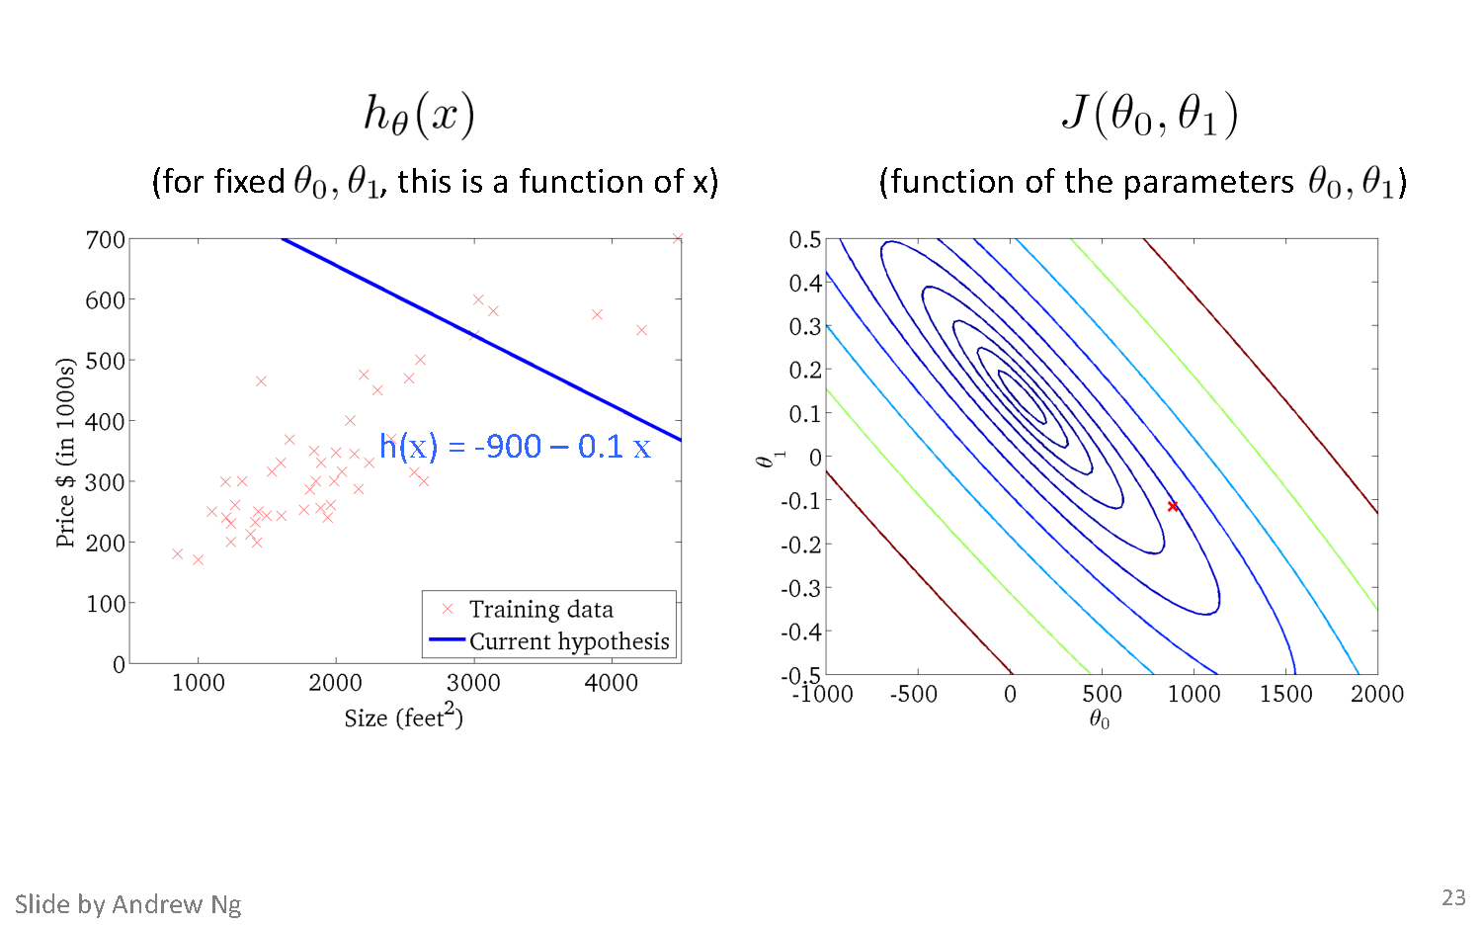
Gradient Descent
constant J contours
(900,-0.1)

Slide 93
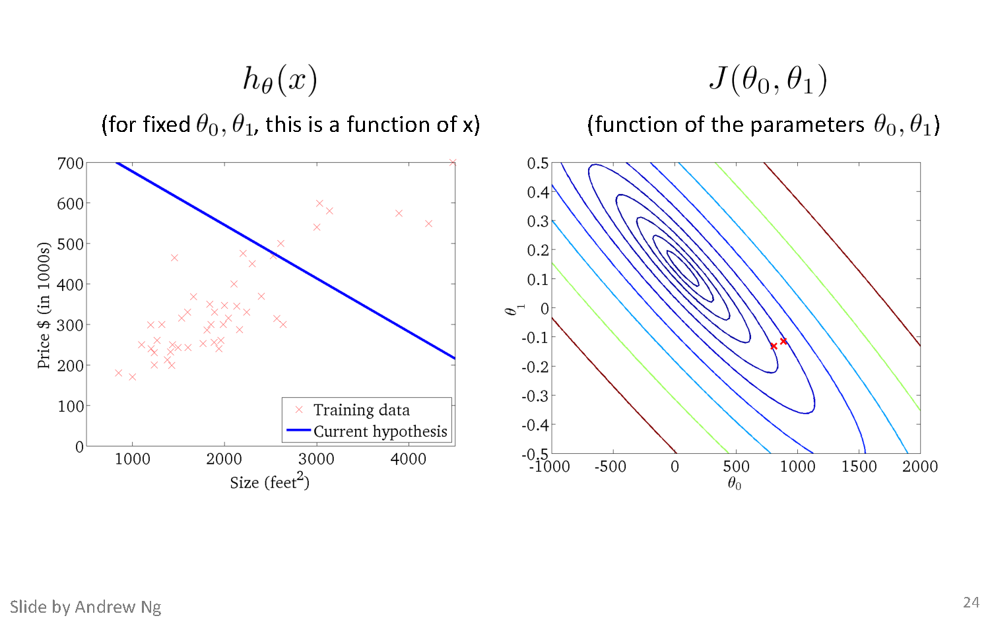
Gradient Descent

Slide 94
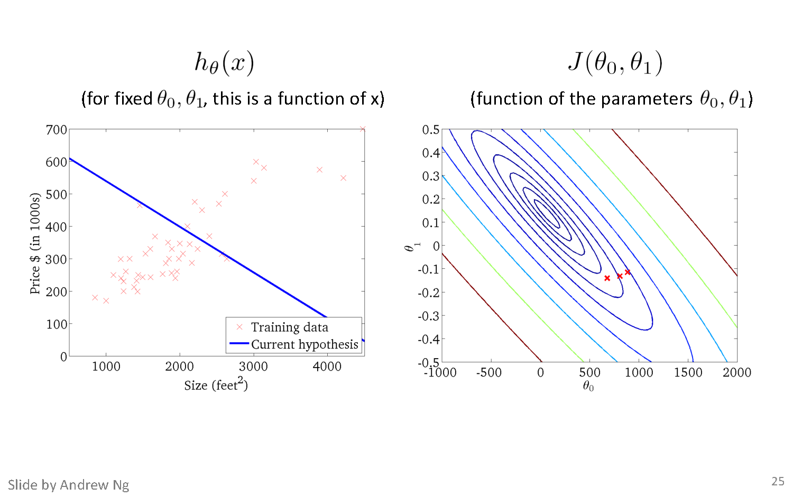
Gradient Descent

Slide 95
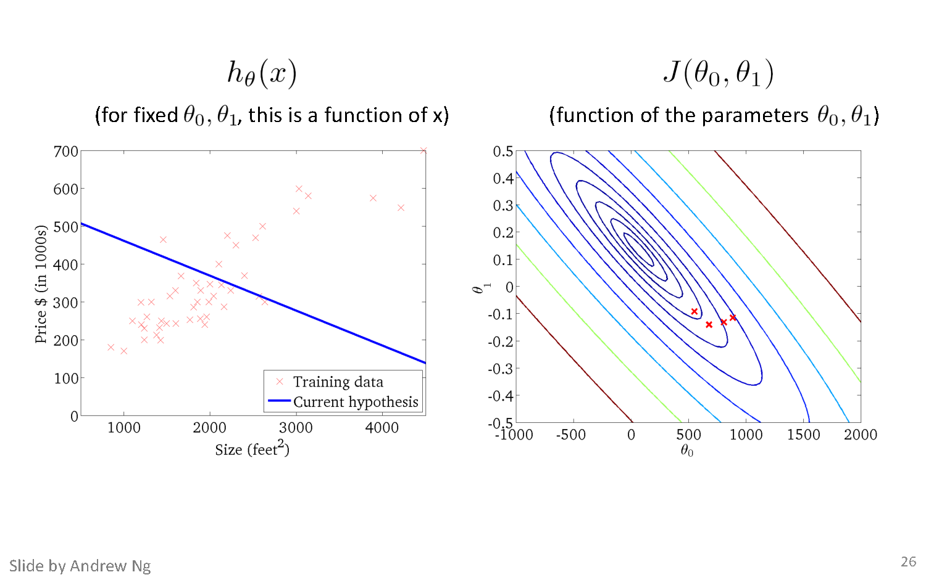
Gradient Descent

Slide 96
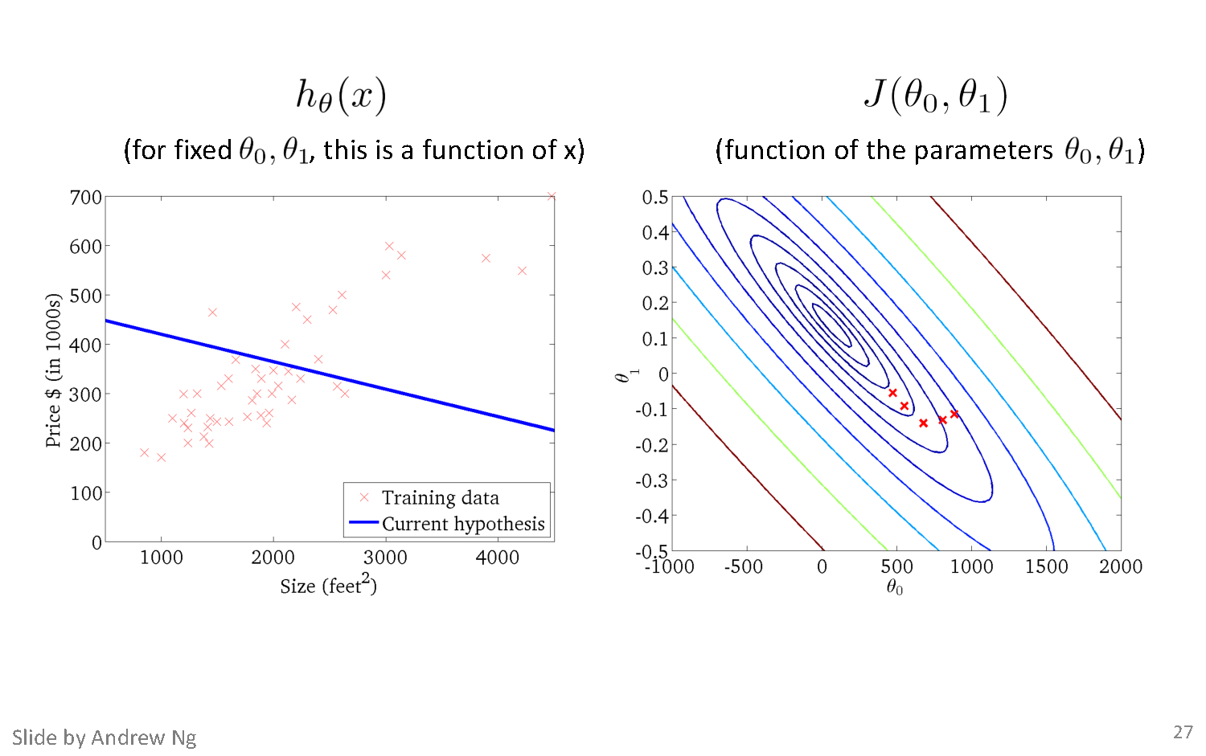
Gradient Descent

Slide 97
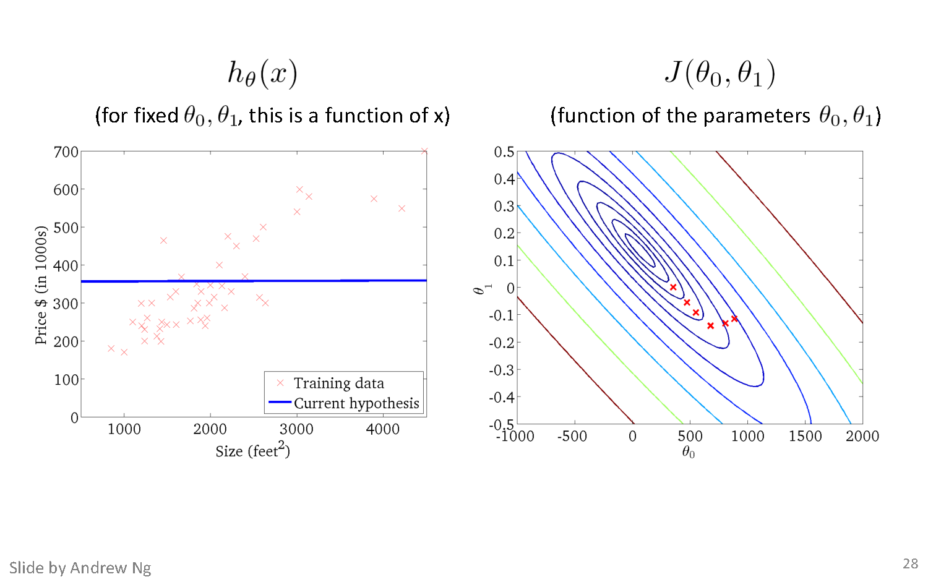
Gradient Descent

Slide 98
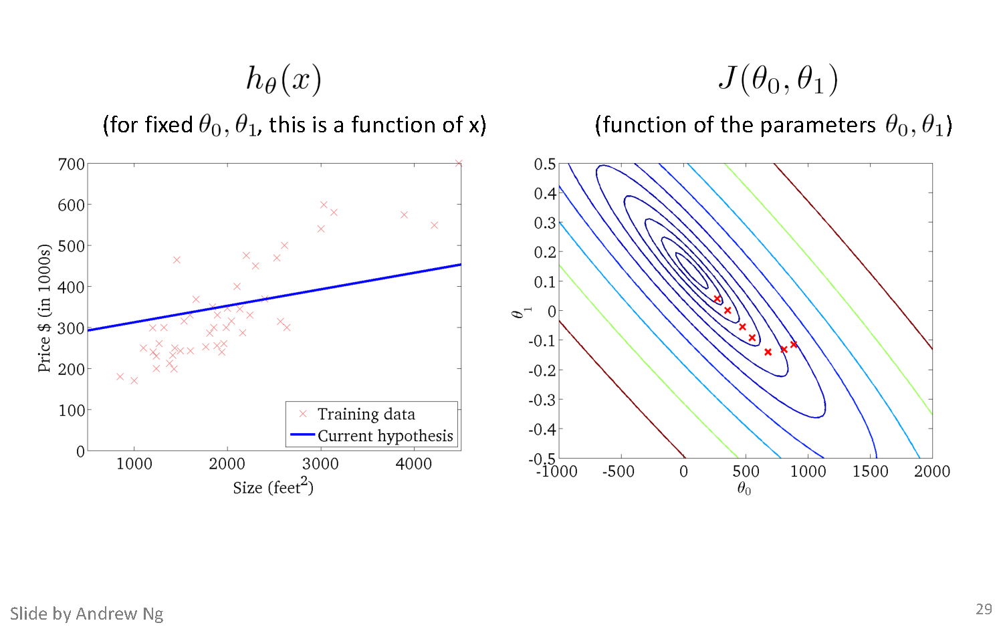
Gradient Descent

Slide 99
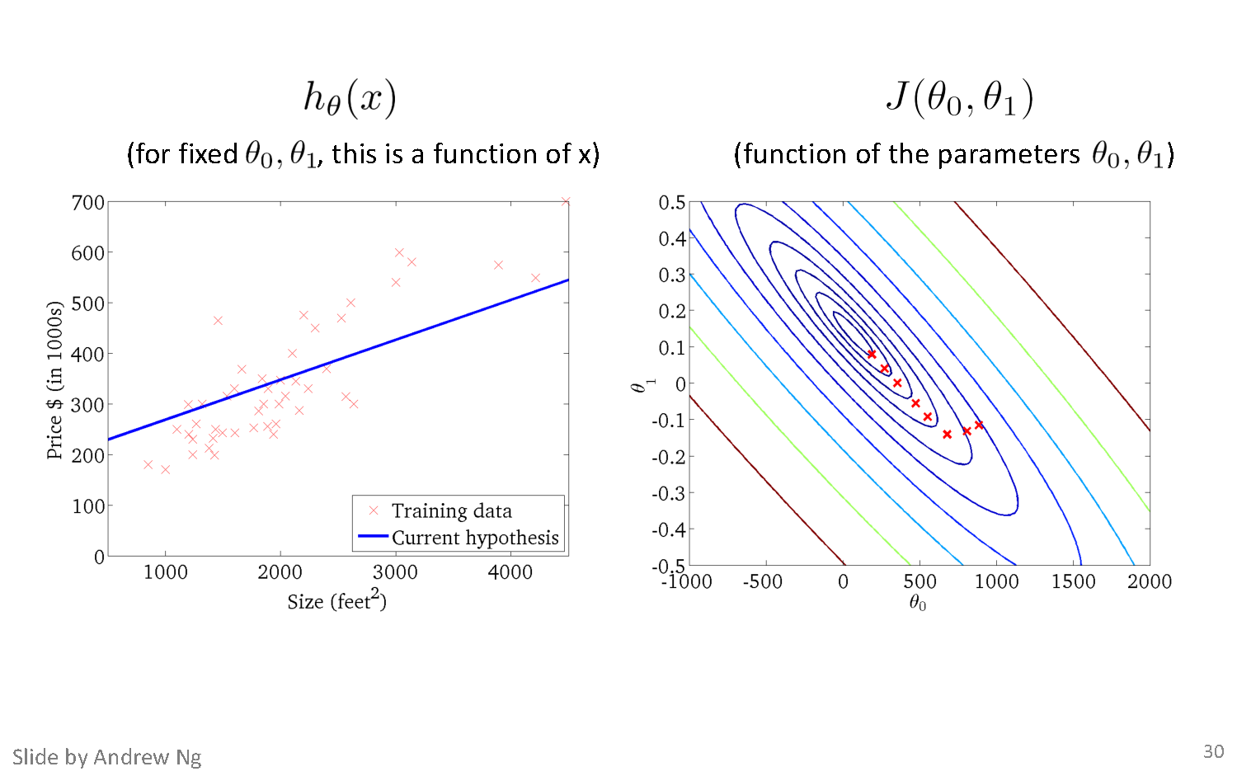
Gradient Descent

Slide 100
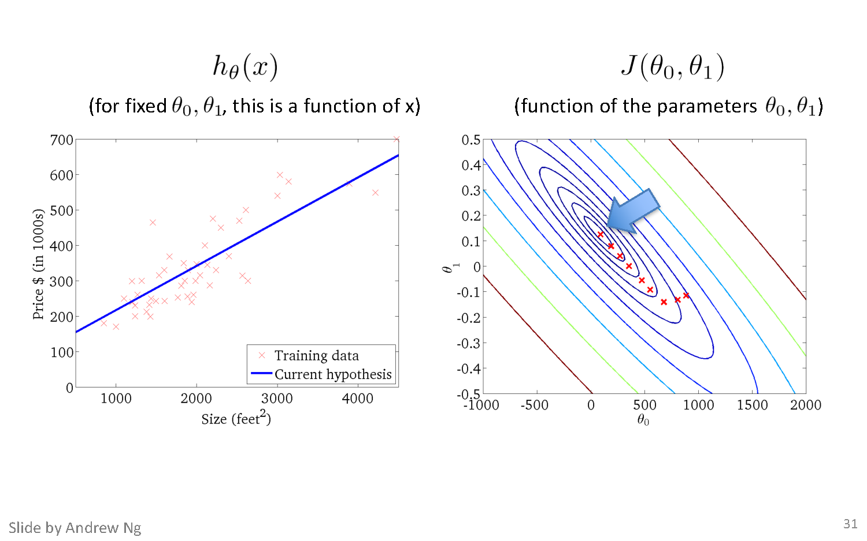
Gradient Descent

Slide 101
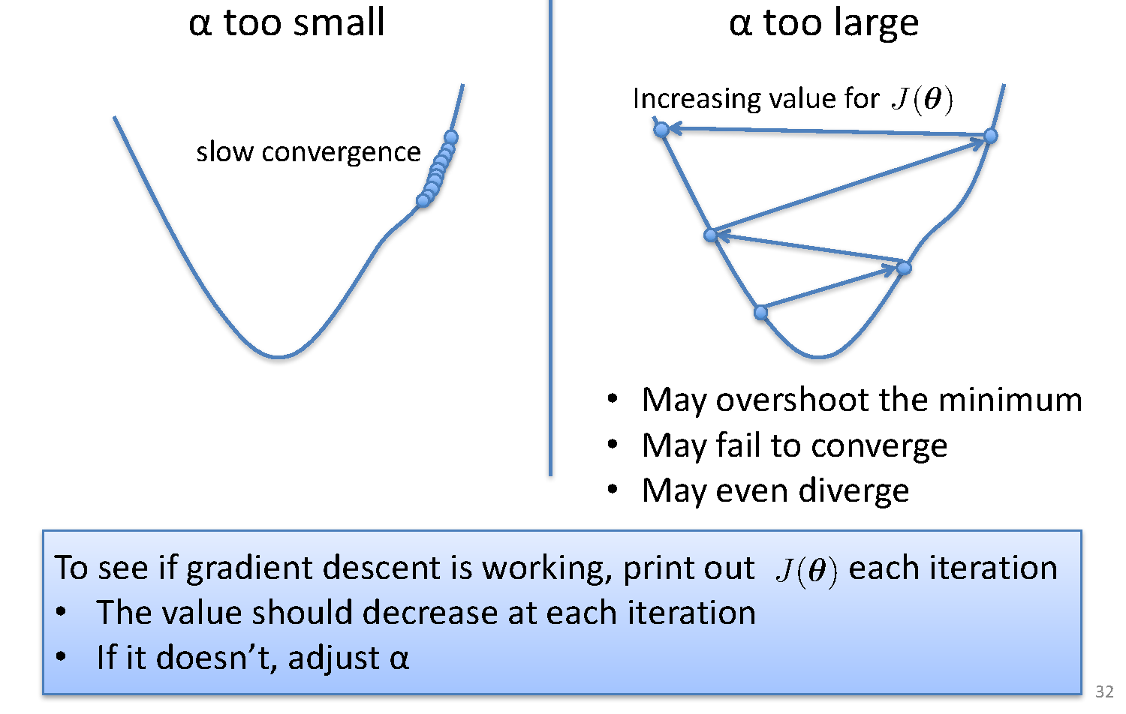
Choosing Step Size

Slide 102
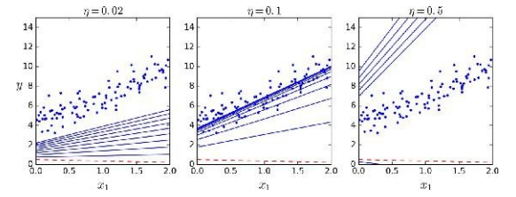
Impact of Learning Rate
α=0.02
α=0.02
α=0.1
α=0.5

Slide 103
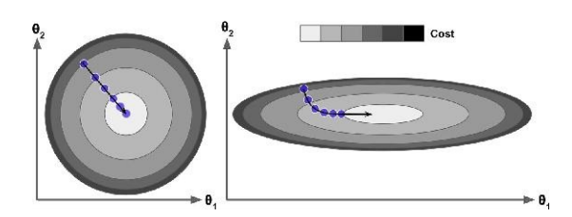
Feature Normalization
Gradient Descent can be slow when feature scales are widely different
Normalization of feature values for same variance needed for faster convergence

Slide 104
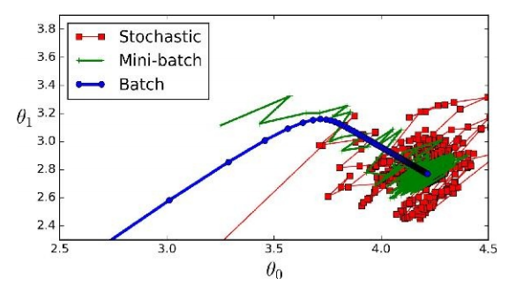
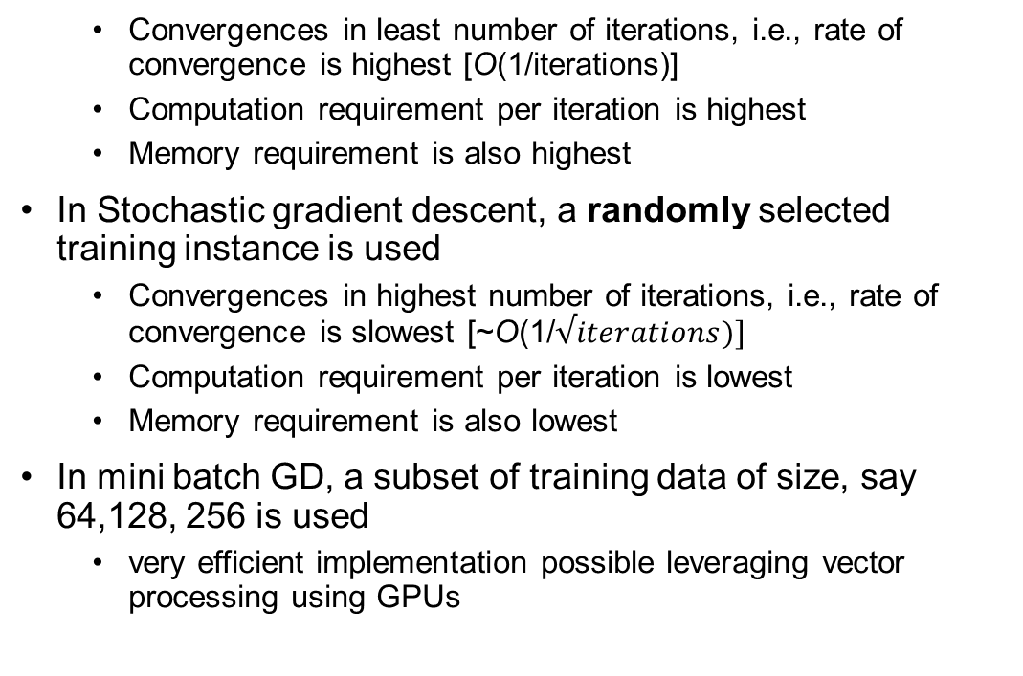
Impact Due To Batch Size
Choice of batch size impacts the rate of convergence of gradient descent (GD)
In Batch GD, entire training set is used to calculate the training error in each iteration/epoch and gradient is calculated and used for weight updates
Convergences in least number of iterations, i.e., rate of convergence is highest [O(1/iterations)]
Computation requirement per iteration is highest
Memory requirement is also highest
In Stochastic gradient descent, a randomly selected training instance is used
Convergences in highest number of iterations, i.e., rate of convergence is slowest [~O(1/$√iterations)]$
Computation requirement per iteration is lowest
Memory requirement is also lowest
In mini batch GD, a subset of training data of size, say 64,128, 256 is used
very efficient implementation possible leveraging vector processing using GPUs

Slide 105

Closed Form Solution Vs. Gradient Descent
O(d³)

Slide 106

Extending to More Complex Model

Slide 107


Fitting a Polynomial Curve

Slide 108
Thank You!
In our next session: Regularization

Slide 109
Linear Regression Regularization
Dr. Sugata Ghosal
CSIS Off-Campus Faculty
BITS Pilani

Slide 110
Session Content
Overfitting of the training data
Effect of Training data size on overfitting
Regularization
Ridge
Lasso
Early Stopping

Slide 111

Quality of Fit

Slide 112

Addressing overfitting
$x_{1}=$ size of house
$x_{2}=$ no. of bedrooms
$x_{3}=$ no. of floors
$x_{4}=$age of house
$x_{5}=$average income in neighborhood
$x_{6}=$ kitchen size
$⋮$
$x_{100}$
Price ($) in 1000’s
Size in feet^2

Slide 113

Addressing overfitting
Reduce number of features.
Manually select which features to keep.
Model selection algorithm
Regularization.
Keep all the features, but reduce magnitude/values of parameters $θ_{j}$.
Works well when we have a lot of features, each/many of which contributes a bit to predicting $y$.

Slide 114


Effect of Training Size on Overfitting
Size of training dataset needs to be large to prevent overfitting
when higher order model is used.
Higher order model
Lower order model

Slide 115

Polynomial Fitting can lead to Overfitting
Underlying target function is quadratic
Linear model results in underfitting with large bias
Polynomial of order 300 results in a large variance

Slide 116

Regularization

Slide 117

Ridge Regularization

Slide 118

Understanding Regularization

Slide 119

Understanding Regularization

Slide 120

Understanding Regularization

Slide 121

Ridge regression

Slide 122

Ridge Regression

Slide 123


Lasso Regularization

Slide 124


Ridge Vs Lasso Regularization
λ = 0
λ = 0
λ = 10
λ = 10⁻⁵
λ = 100
λ = 1
Lasso
λ = 0
λ = 0
λ = 0.1
λ = 10⁻⁷
λ = 1
λ = 1
λ
Ridge

Slide 125

Early Stopping
Do Not Over train to prevent overfitting
Stop training once error on the validation set starts showing an upward trend, even if the error on the training set keeps decreasing

Slide 126
Thank You!
In our next session: Bias Variance Decomposition

Slide 127
Linear Regression Bias Variance Decomposition
Dr. Sugata Ghosal
CSIS Off-Campus Faculty
BITS Pilani

Slide 128
Session Content
What is Bias, Variance
Sources of generalization error
Bias Variance Tradeoff
Bias Variance Decomposition

Slide 129
Bias and Variance
Bias: difference between what you expect to learn (“average” hypothesis) and truth
Measures how well you expect to represent true solution
Decreases with more complex model
Variance: difference between what you expect to learn and what you learn from a particular dataset
Measures how sensitive learner is to specific dataset
Increases with more complex model

Slide 130
Sources of Error
Model’s generalization error can be expressed as the sum of three very different errors
Bias
due to wrong assumptions, such as model order is less than actual order
most likely to underfit the training data.
Variance
Due to model order higher than actual
excessive sensitivity to small variations in the training data.
overfit the training data.
Irreducible error
due to the noisiness of the data itself.
The only way to reduce this error is to clean up the data
Bias Variance Tradeoff
Increasing a model’s complexity will typically increase its variance and reduce its bias.
Conversely, reducing a model’s complexity increases its bias and reduces its variance.

Slide 131

Bias Variance Tradeoff
Bias/Variance is a Way to Understand Overfitting and Underfitting

Slide 132

Example with Synthetic Data

Slide 133

Example

Slide 134

Bias Variance Decomposition

Slide 135

Bias Variance Decomposition

Slide 136

Bias Variance Decomposition

Slide 137

Bias Variance Decomposition

Slide 138

Bias Variance Decomposition
Variance of prediction
noise
True prediction
True value
4 5 6 7 8
bias

Slide 139
Thank You!
In our next session: Classification Models

